Slide 1
Webinar Norms
Participants are muted when they enter the webinar.
Use the chat box to ask or respond to questions during the presentation.
Webinar will be recorded, but participant names are not connected to images.
The chat box will not be included in the recording.
For live captioning, click CC on your control bar.

Slide 2
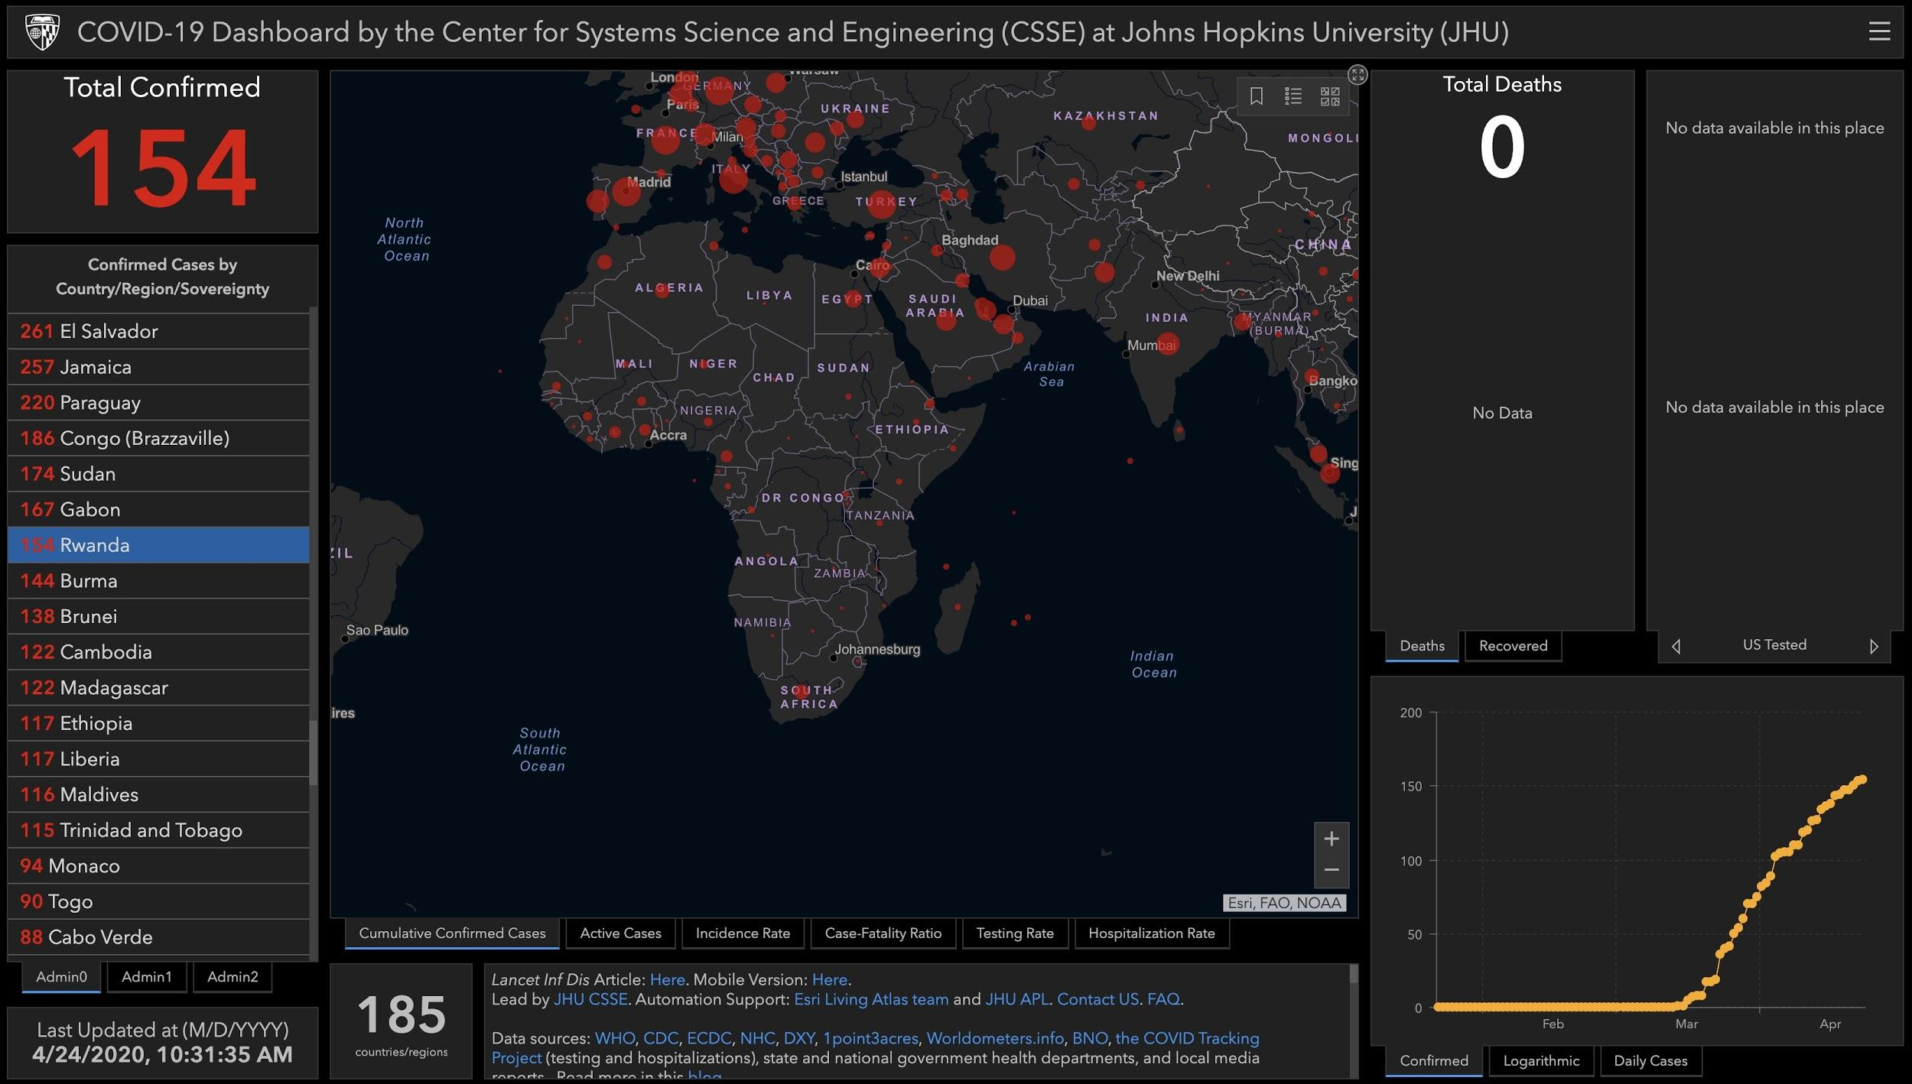
Global Views of COVID 19
The Perspective from Rwanda
Coronavirus COVID-19 Global Cases by the Center for Systems Science and Engineering (CSSE) at Johns Hopkins University (JHU), April 24, 2020

Slide 3
Introduction and Overview
Introduction to ORIAS
Experiencing the pandemic and lockdown in Rwanda: personal reflections and effects on biodiversity conservation
Q & A
Closing Poll
Resources & Future Professional Learning with UCB PDP
Notes:
Beth:

Slide 4
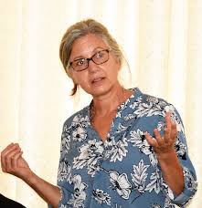
Beth Kaplin
Beth is a Professor of Conservation Science in the College of Science & Technology at University of Rwanda (UR). She is Director of the Center of Excellence in Biodiversity & Natural Resource Management at UR, a research center that contributes science to policy for sustainable development. She teaches and mentors BSc, MSc and PhD students. Beth was in the Environmental Studies Dept at Antioch University New England, USA for 20 yrs (1998-2018) where she mentored MSc & PhD students, served as PhD program director, and founded and directed the Center for Tropical Ecology & Conservation. She received her BSc in wildlife biology from Colorado State University, and MSc and PhD in Zoology from University of Wisconsin-Madison.
From 2006 to 2015, Beth raised over 1 million USD to develop BSc and MSc programs in biodiversity conservation at UR with funding from the MacArthur Foundation. She is an affiliated Research Professor in the School for the Environment at University of Massachusetts-Boston, and Senior Fellow at the Center of Global Governance and Sustainability. She maintains a research program with her students on forest ecology, primates, protected areas conservation, and human-wildlife interactions that began in 1990 when she first came to Rwanda. Her current projects include buffer zones and biodiversity indicators, upgrading the National Herbarium of Rwanda, traditional knowledge systems, primate ecology and conservation, and developing a biodiversity information system for effective policy-making and climate change adaptation. She has a home in Vermont with her husband, and has a 25 year old daughter living in Boston. She currently lives full time in Rwanda.

Slide 5
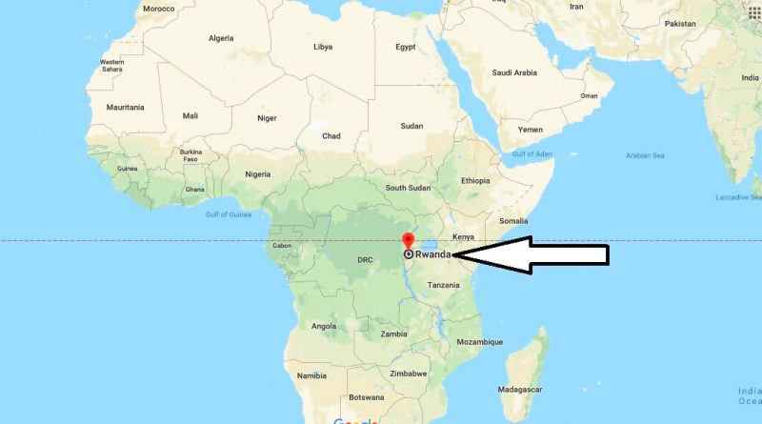

Slide 6
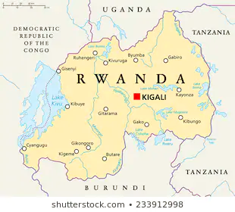

Slide 7
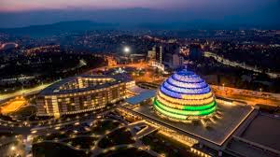
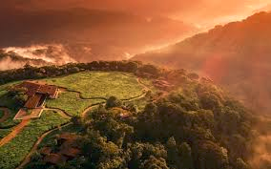
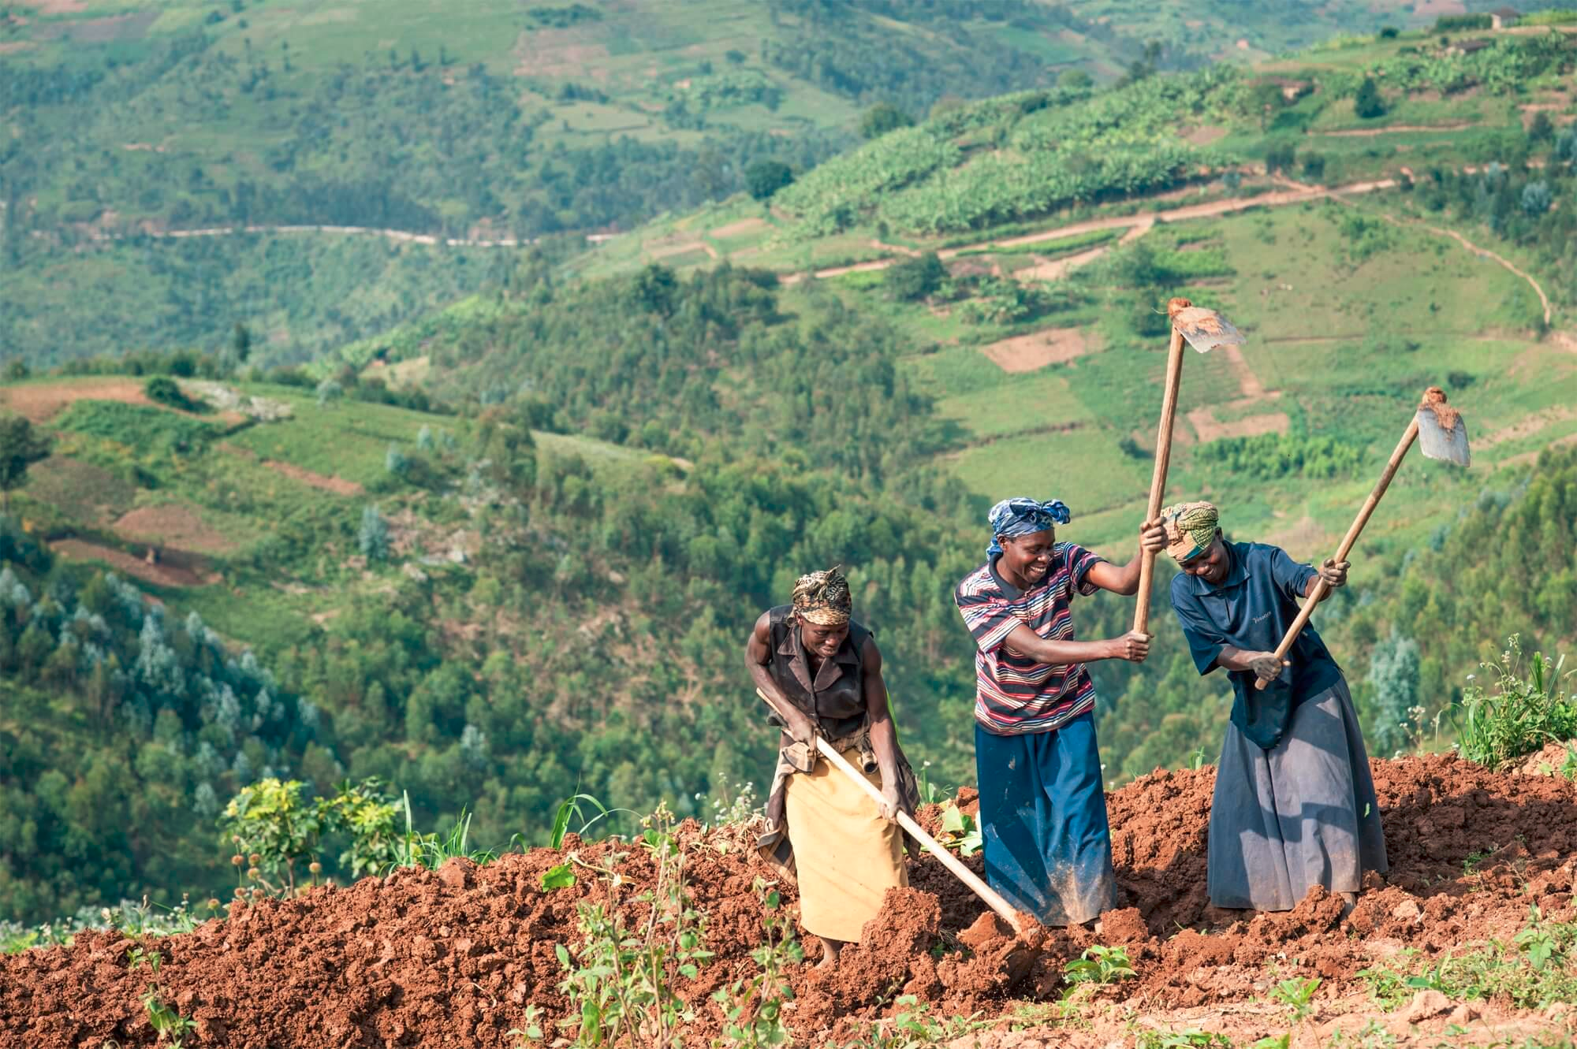

Slide 8
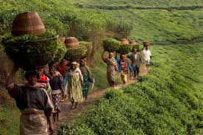
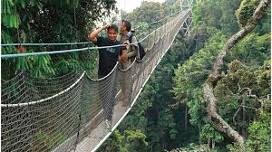
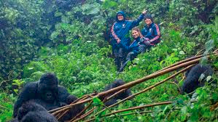

Slide 9
Being on lockdown in Rwanda
Notes:
Everything closes Dorms closed no flights in or out

Slide 10
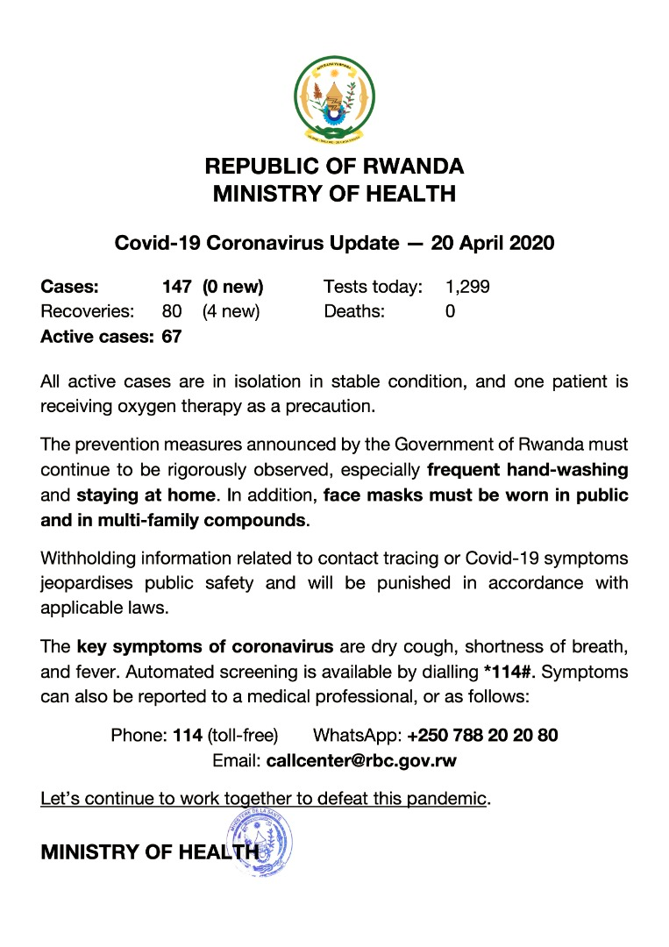

Slide 11
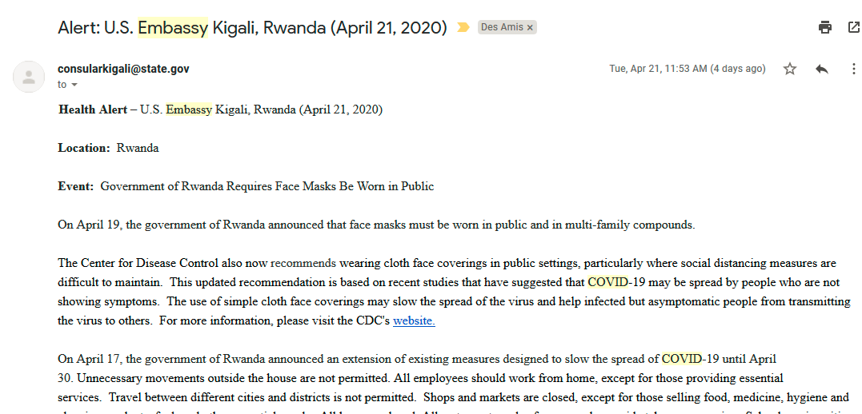

Slide 12
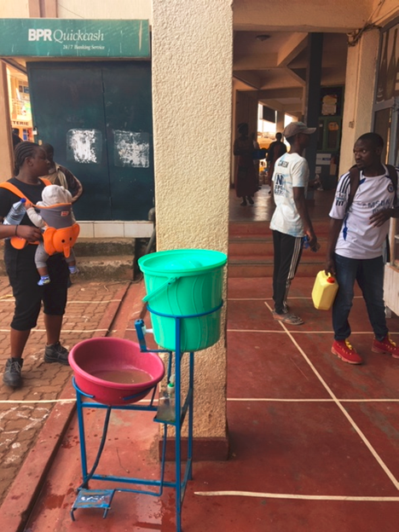
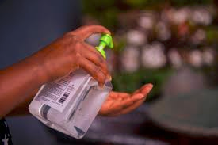

Slide 13
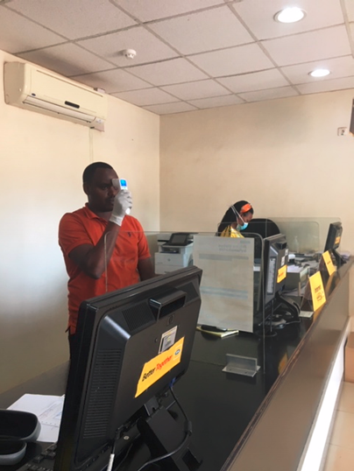
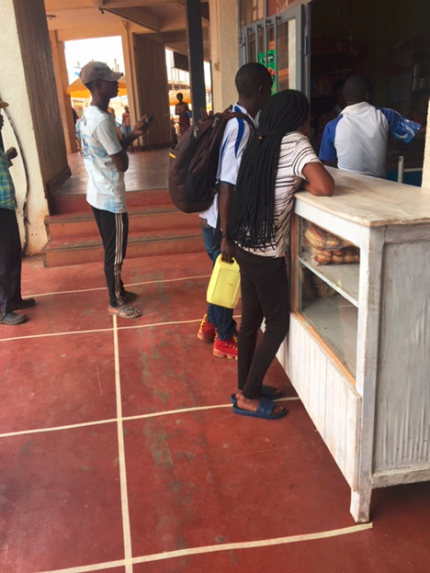

Slide 14
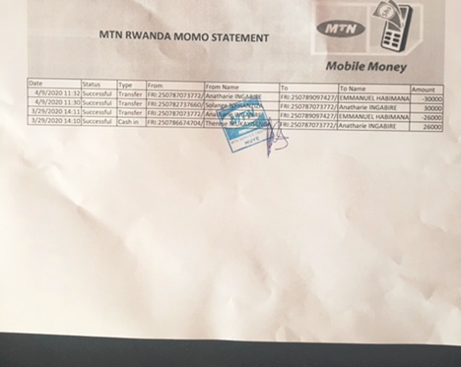
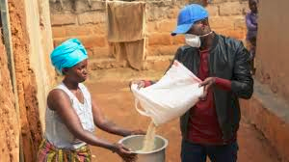
Notes:
People suffering, needing assistance, no work, day to day money and no savings, neighborhoods helping each other

Slide 15
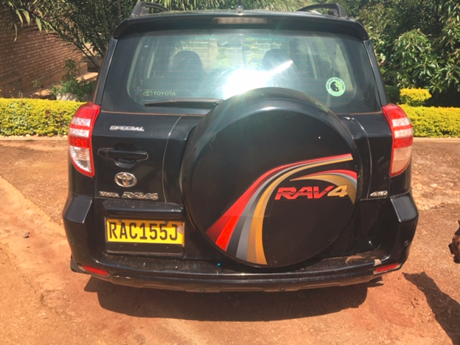
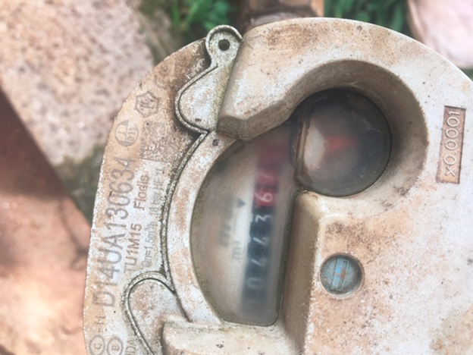

Slide 16
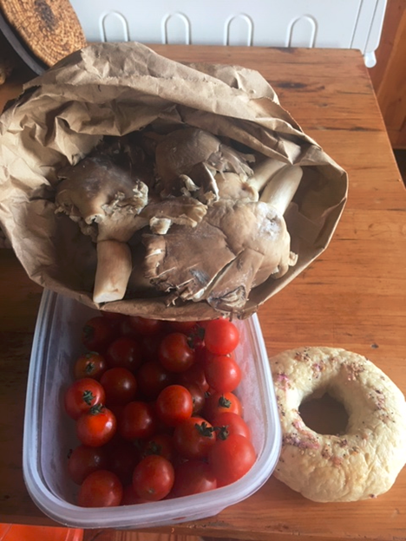

Slide 17
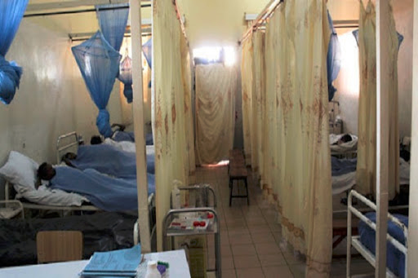
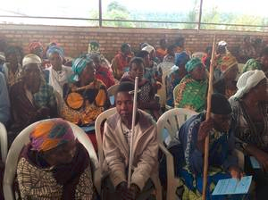
The health care system in Rwanda

Slide 18
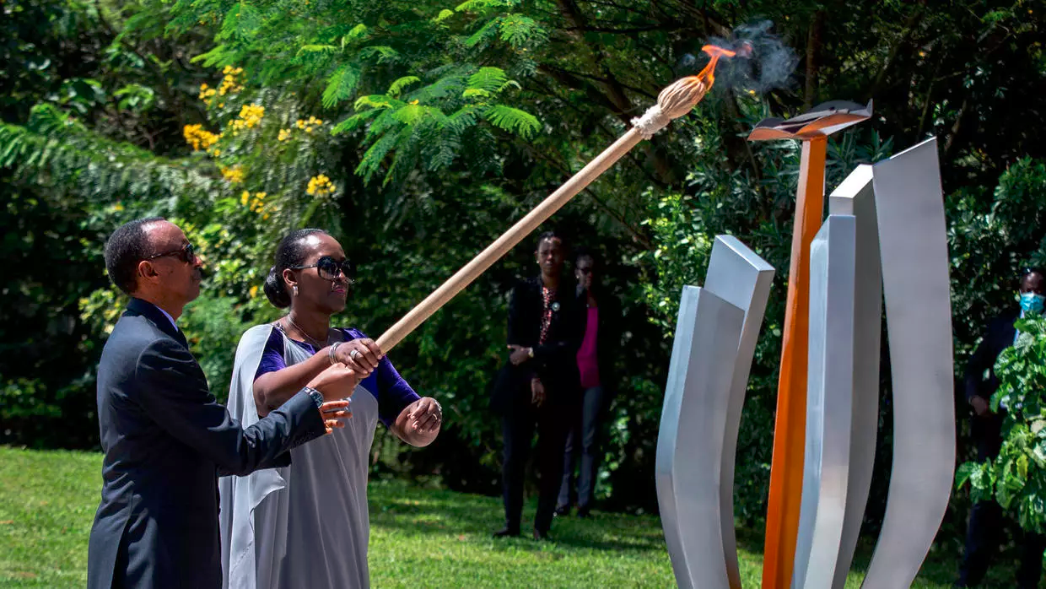

Slide 19
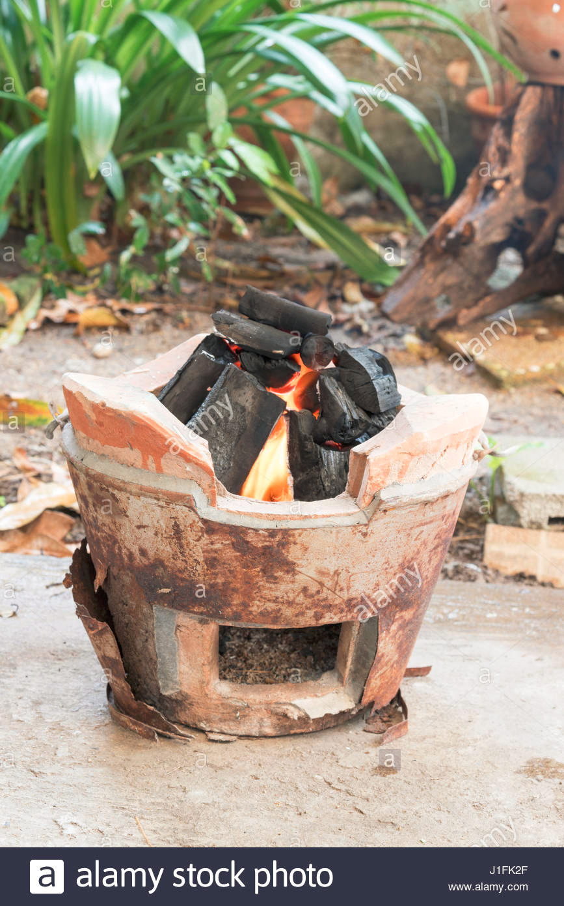
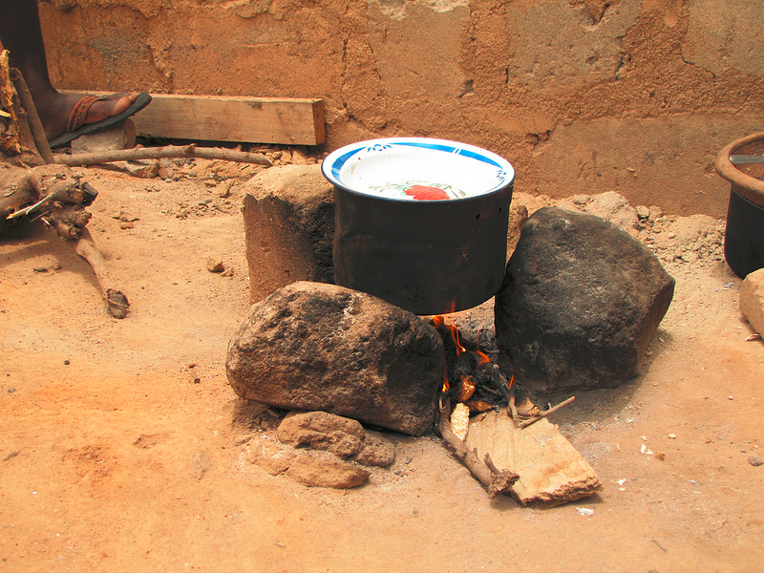

Slide 20
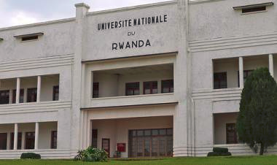
Our new worklife

Slide 21
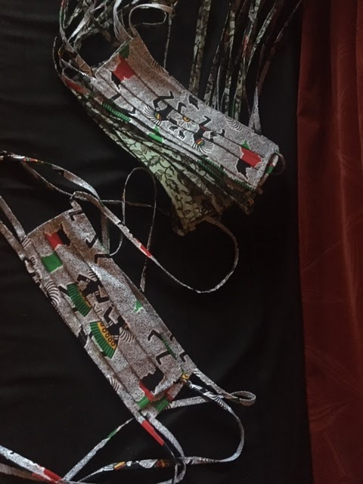
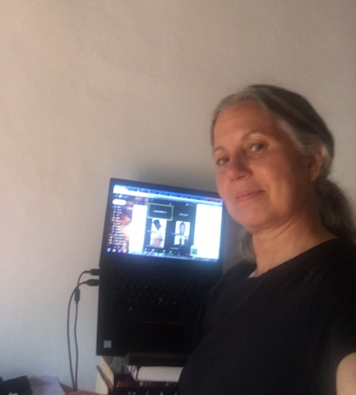
Managing the Center on lockdown

Slide 22
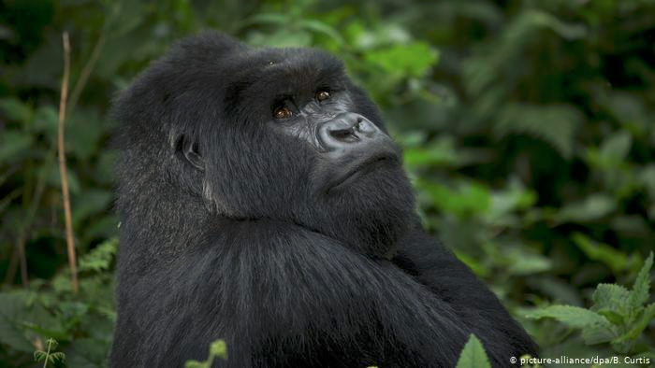
Impacts on wildlife and conservation

Slide 23
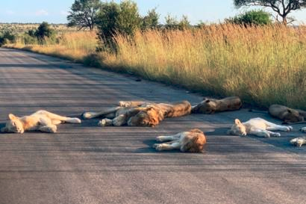
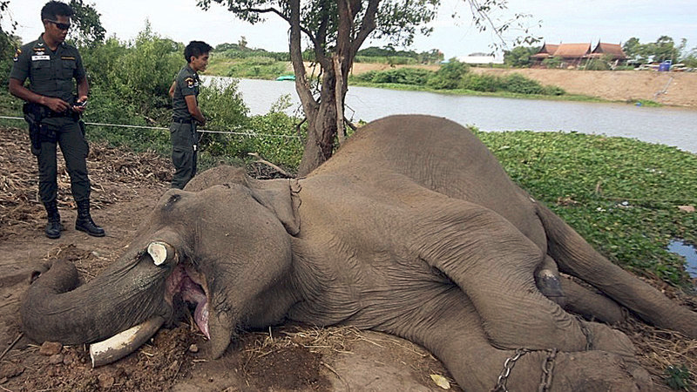

Slide 24
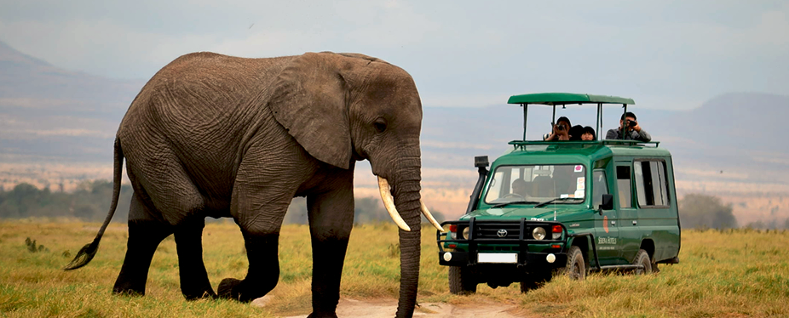
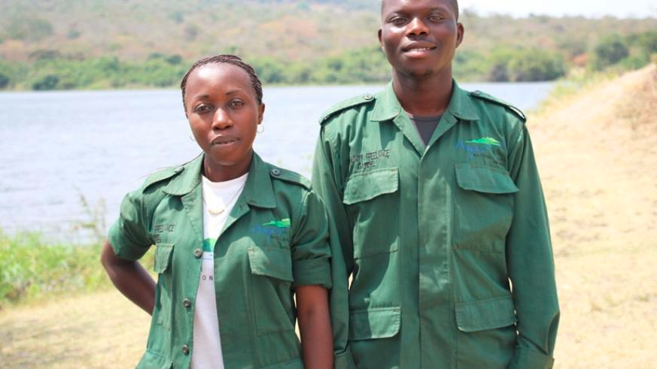
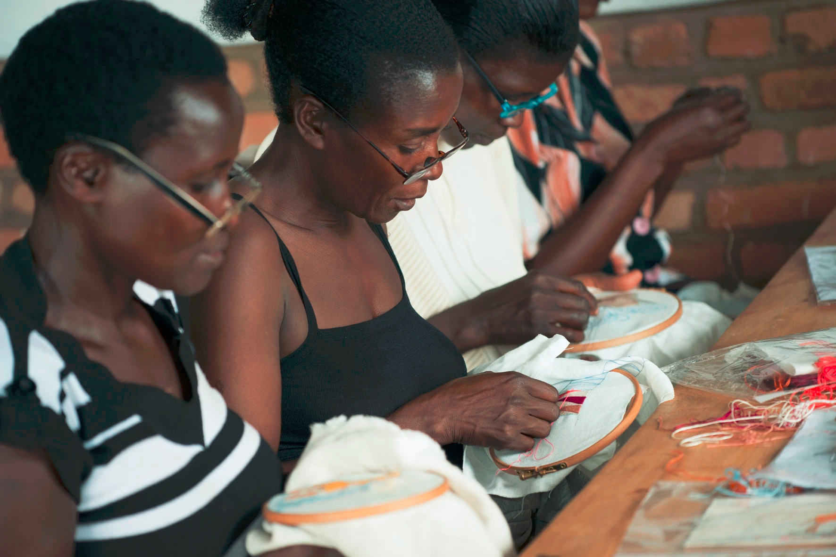

Slide 25
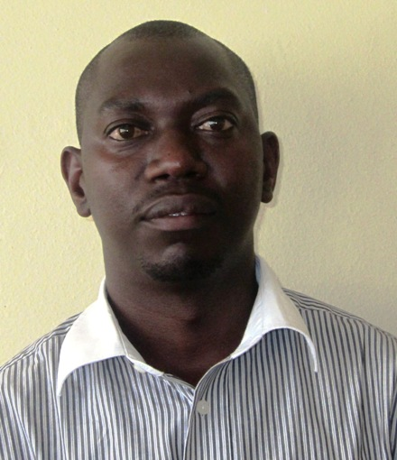
Nsengimana Venuste
Nsengimana Venuste is a Doctor in Agronomy and Bio-Engineering from the University of Liège – Gembloux Agro Bio Tech, Belgium. In addition to the Bachelor’s degree in Biology – Education awarded by the former National University of Rwanda, Dr. Nsengimana Venuste has a Master’s degree in Biodiversity Conservation awarded by the University of Rwanda, College of Science and Technology; and a Postgraduate certificate in teaching and Learning in Higher Education awarded by the University of Rwanda, College of Education.
He serves the University of Rwanda as a Lecturer of Biology, and a mentor of Bachelor, Master and PhD students in Biology - Education. Dr. Nsengimana Venuste is the Associate Researcher in the African Centre of Excellence for Innovative Teaching and Learning Mathematics and Science (ACEITLMS) based in the University of Rwanda, College of Education. He also serves as the Deputy Director of the Centre of Excellence in Biodiversity and Natural Resources Management (CoEB) based in the University of Rwanda, College of Science and Technology. The area of research of Dr. Nsengimana Venuste is Ecology and Conservation Biology (Applied Entomology), and Biology – Education.

Slide 26
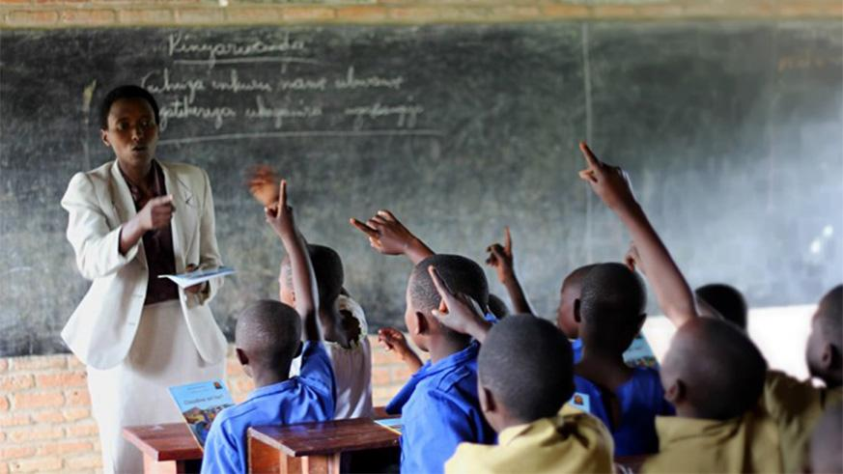
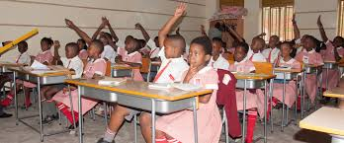
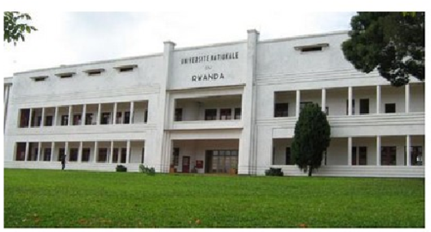
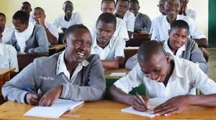
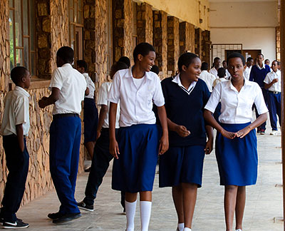
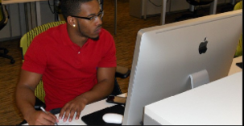
Education System in Rwanda

Slide 27
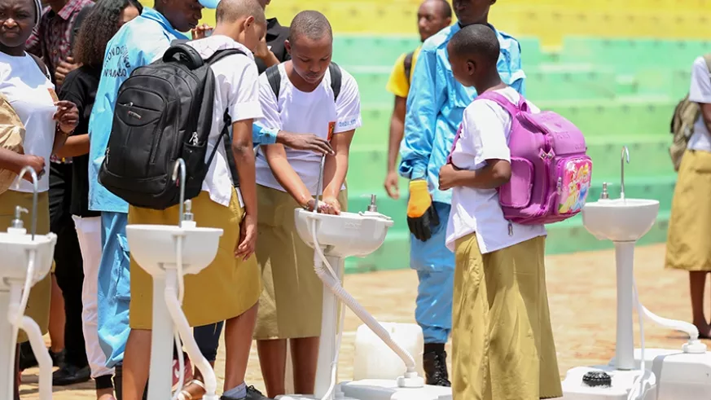
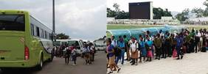
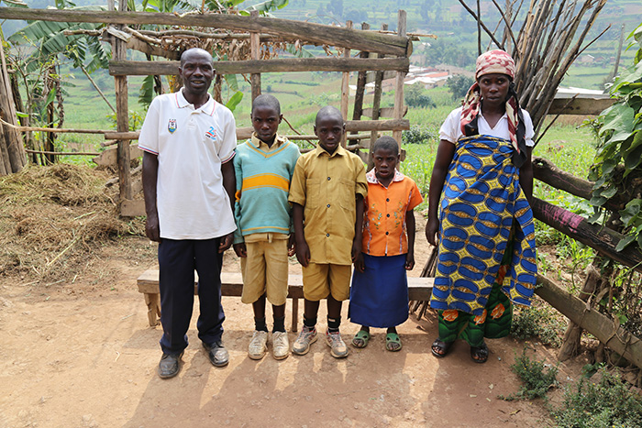
COVID - 19: Adaptations at School level and measures taken by the Government in Rwanda

Slide 28
COVID - 19: Adaptations and measures taken in Rwanda

Slide 29
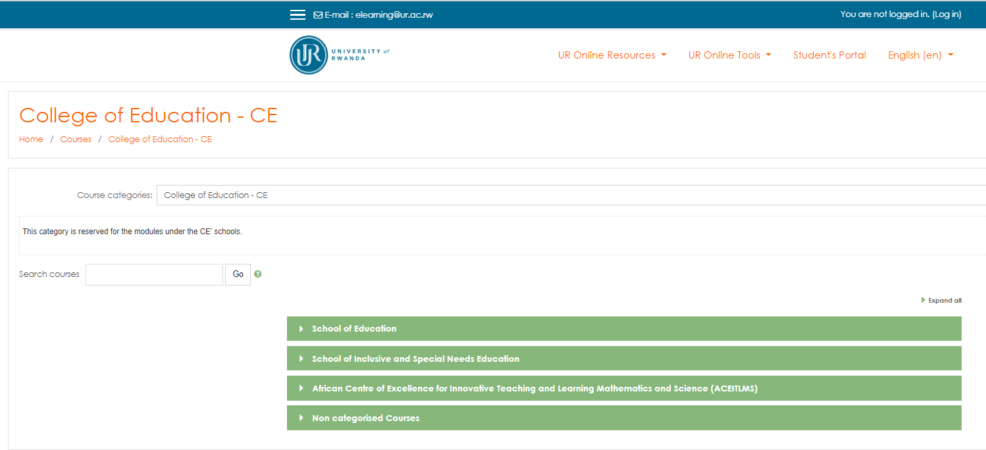
COVID - 19: Adaptations and measures taken in Rwanda

Slide 30
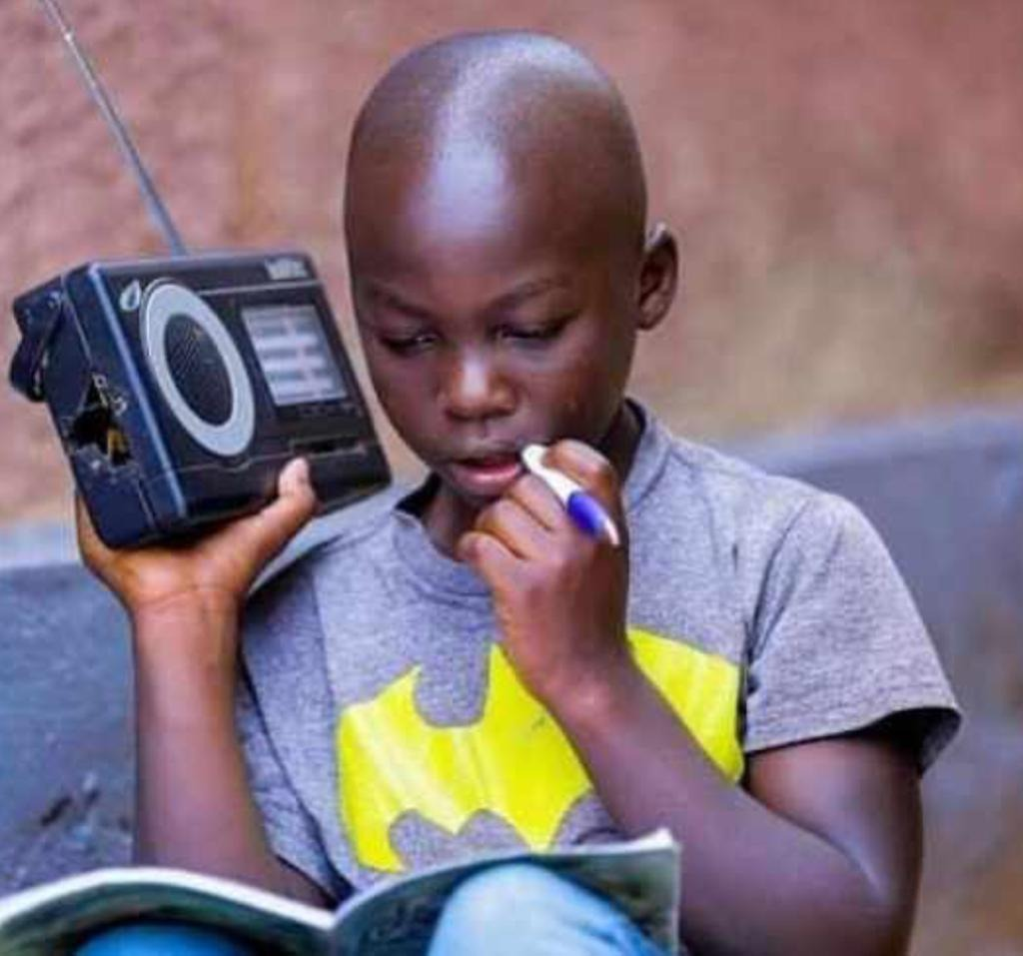
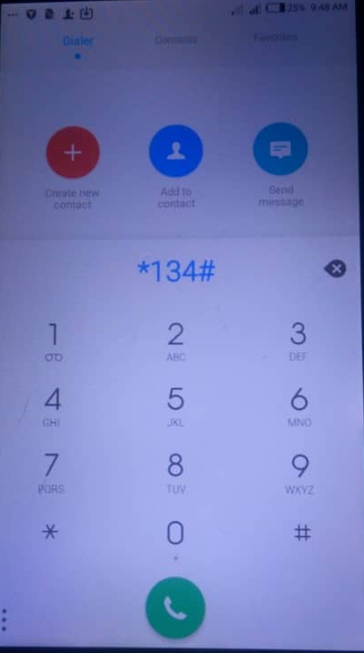
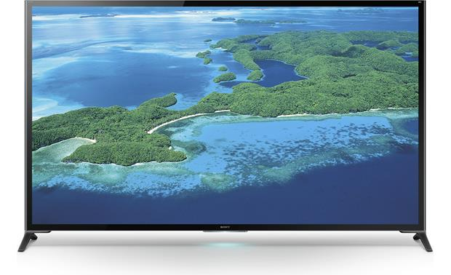
COVID - 19: Adaptations and measures taken in Rwanda

Slide 31
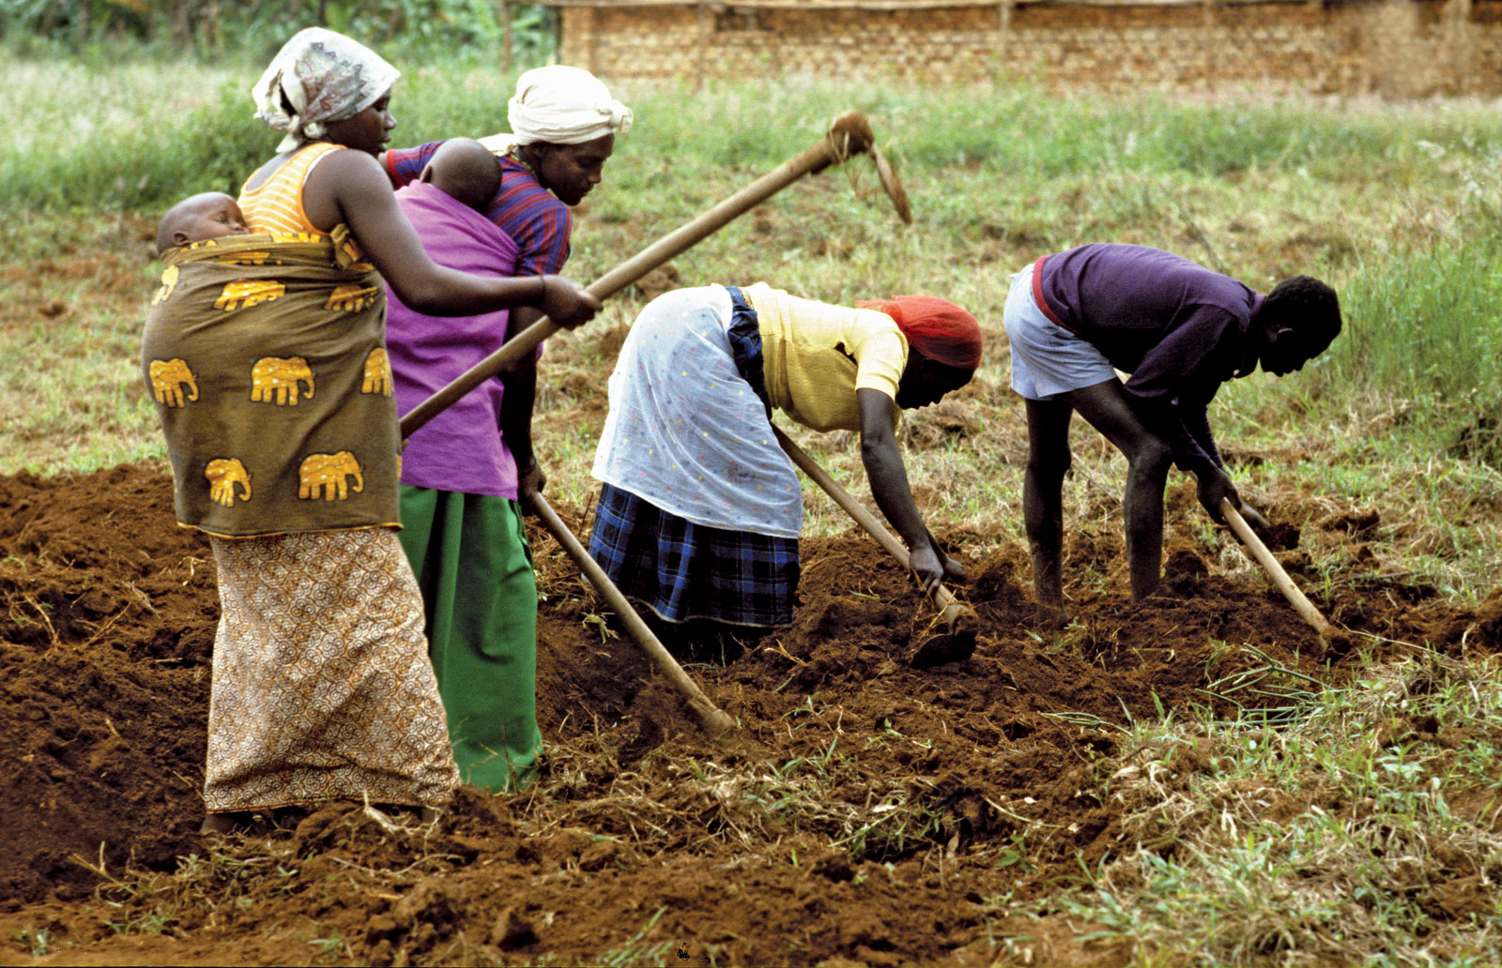
COVID - 19: Challenges

Slide 32
COVID - 19: Challenges
Accessibility of tools (radio, mobile phone, TV)
Lack of internet
Termination of contracts (private schools)

Slide 33
Question and Answer Period

Slide 34
About UC Berkeley Professional Development Providers (UCBPDP)
Community of Practice since 2017
Collaborative of 13 programs from across UC Berkeley providing PD for PK12
Committed to providing evidence-based PD for educators that supports deeper learning and continuous improvement
http://bit.ly/BerkeleyPDP

Slide 35
UCBPDP Resources
UCBPDP Website: http://bit.ly/BerkeleyPDP
UCBPDP Calendar: bit.ly/ucbpdp-calendar
UCBPDP Recordings and Resources: https://tinyurl.com/PDP-webinar-recording
Covid19 Resources for Educators: https://tinyurl.com/ucb-covid-resources
http://bit.ly/BerkeleyPDP
Notes:
Link to post in Chat Box: https://tinyurl.com/u5ko9zk

