Slide 1

Webinar Norms
Participants are muted when they enter the webinar.
Please remain muted during panelist presentations.
For live captioning, click CC on your control bar.
Live captioning is only available in the main room, not in the breakout rooms.
Use the chat box to add comments/communicate during the presentation.
This meeting is NOT being recorded.

Slide 2
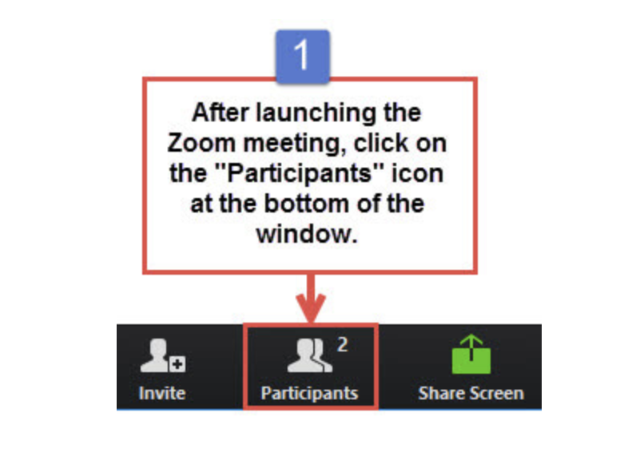
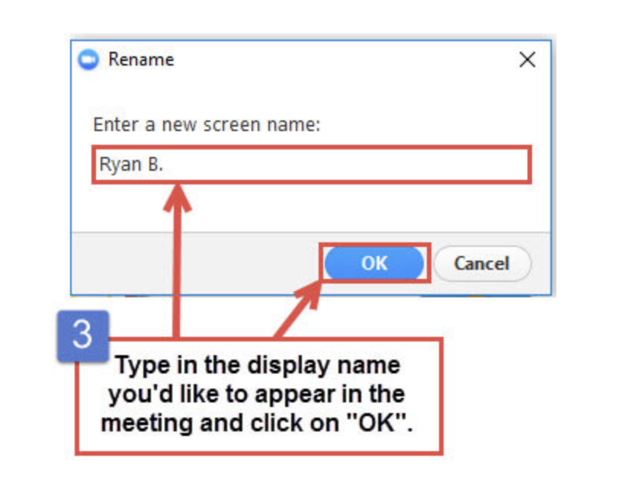
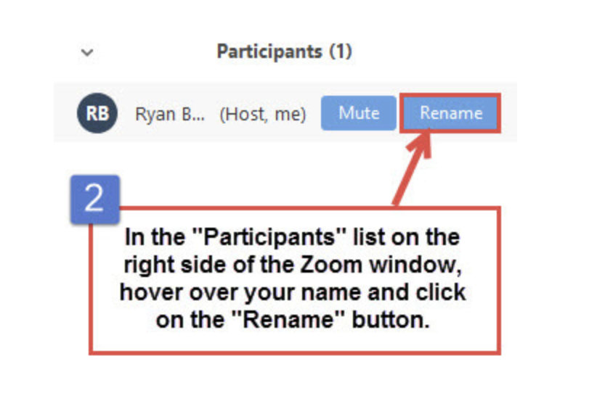
Quick (Optional) Name Change
Change your name to Name - Location.
Example: Shane C. - Berkeley, California, USA

Slide 3
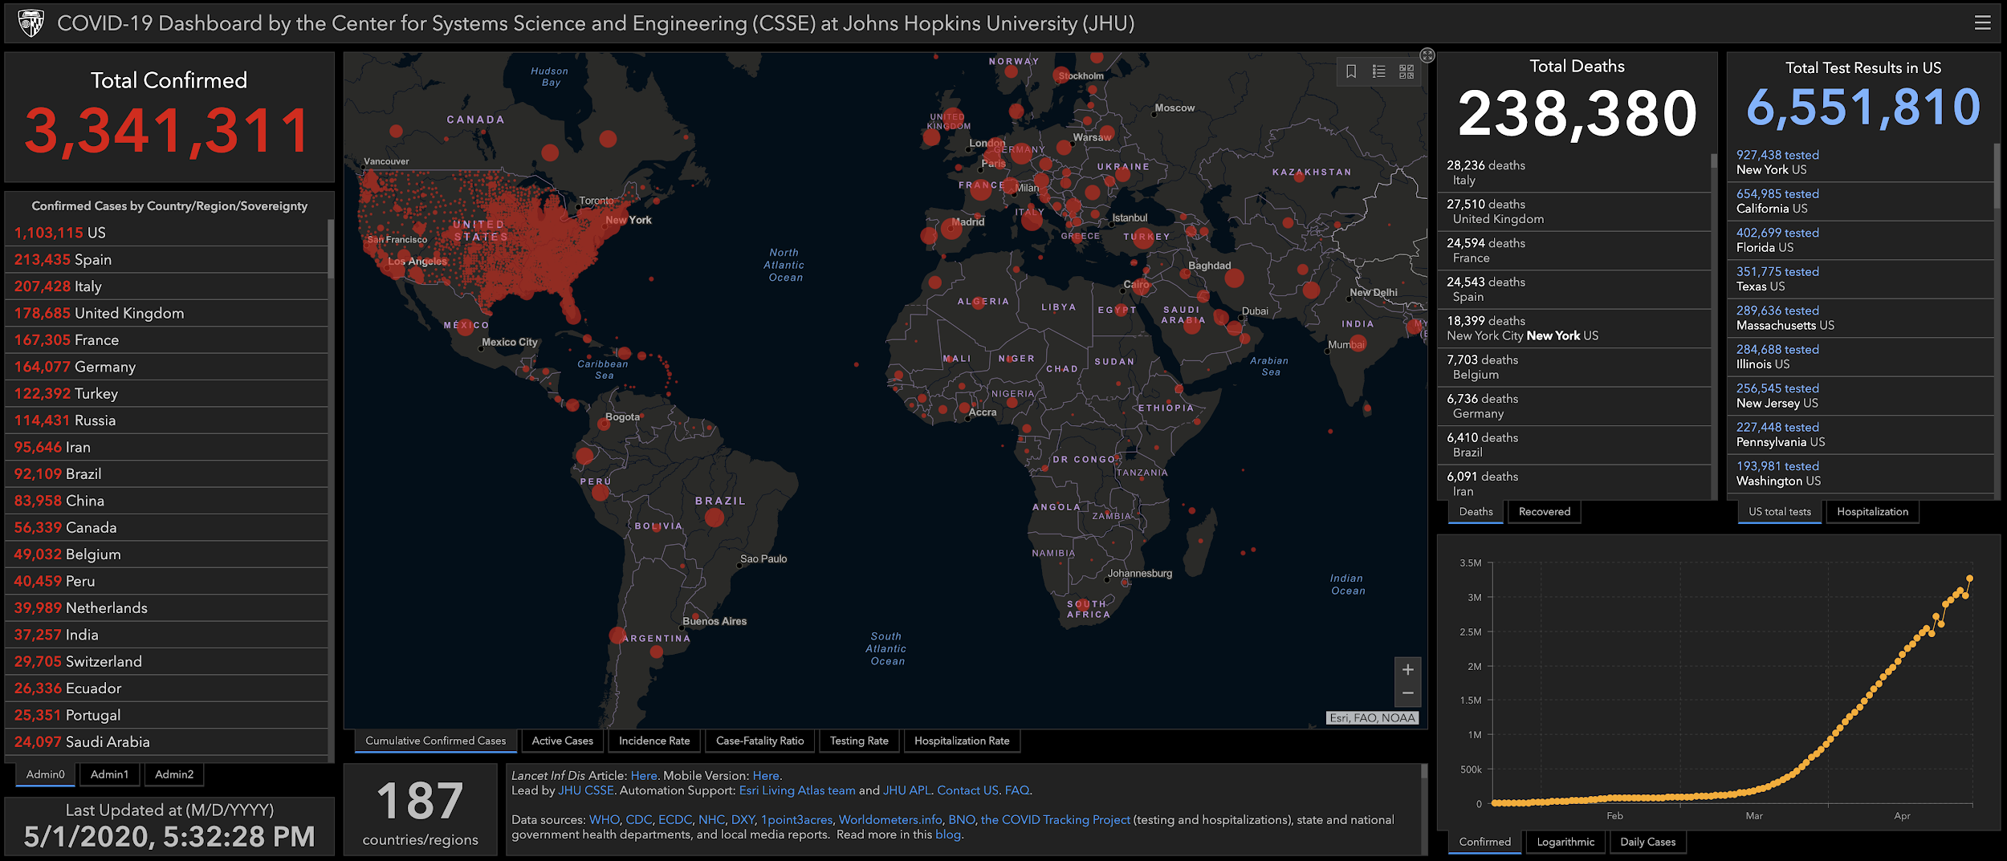
Global Views of COVID 19
Special Session of the Transatlantic Educator’s Dialogue
Coronavirus COVID-19 Global Cases by the Center for Systems Science and Engineering (CSSE) at Johns Hopkins University (JHU), May 1, 2020

Slide 4
Agenda
11:00 - 11:05 Welcome (Shane and Sydney)
11:05 - 11:15 TED Program & TED Alumni Program (Jeremie & Jennifer)
11:15 - 12:00 TED Alumni Panel Presentations
Daily teaching schedule
Methods for interacting with students (packet, internet, etc.) and parents/families
Level of access to students and relationships with students
What is the view looking forward?
12:00 - 12:25 Group Discussions
12:25 - 12:30 Chat Box Group Share & Optional Email Share
12:30 - 12:50 (Optional) Continued Group Discussion
12:50 - 1:00 Group Discussion Debrief

Slide 5
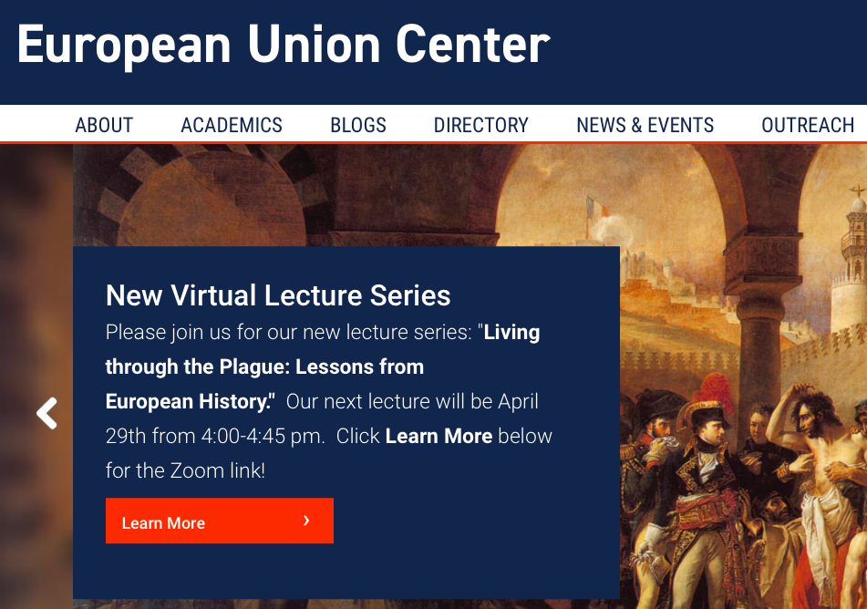
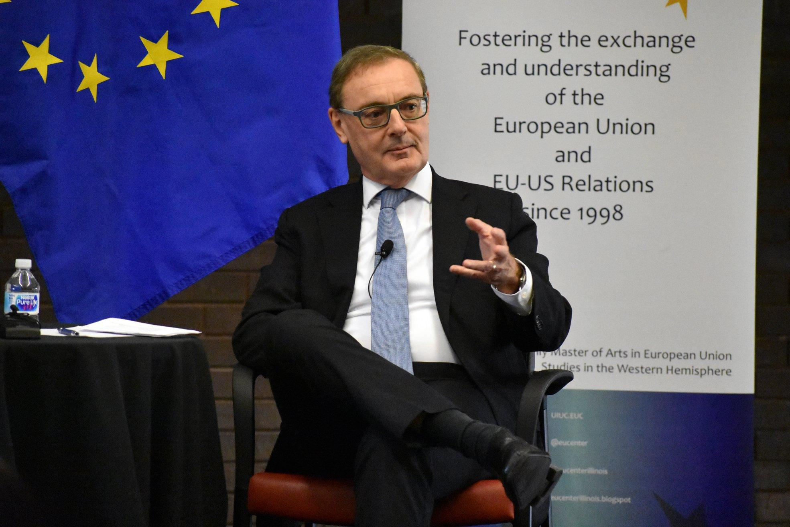
What is the EU Center?
Interdisciplinary area studies center at the University of Illinois
Jean Monnet Center of Excellence through Erasmus+ program
U.S. Department of Education Title VI National Resource Center
Master’s program in European Union Studies
K-14 resources: https://europe.illinois.edu/outreach/k-14-opportunities

Slide 6
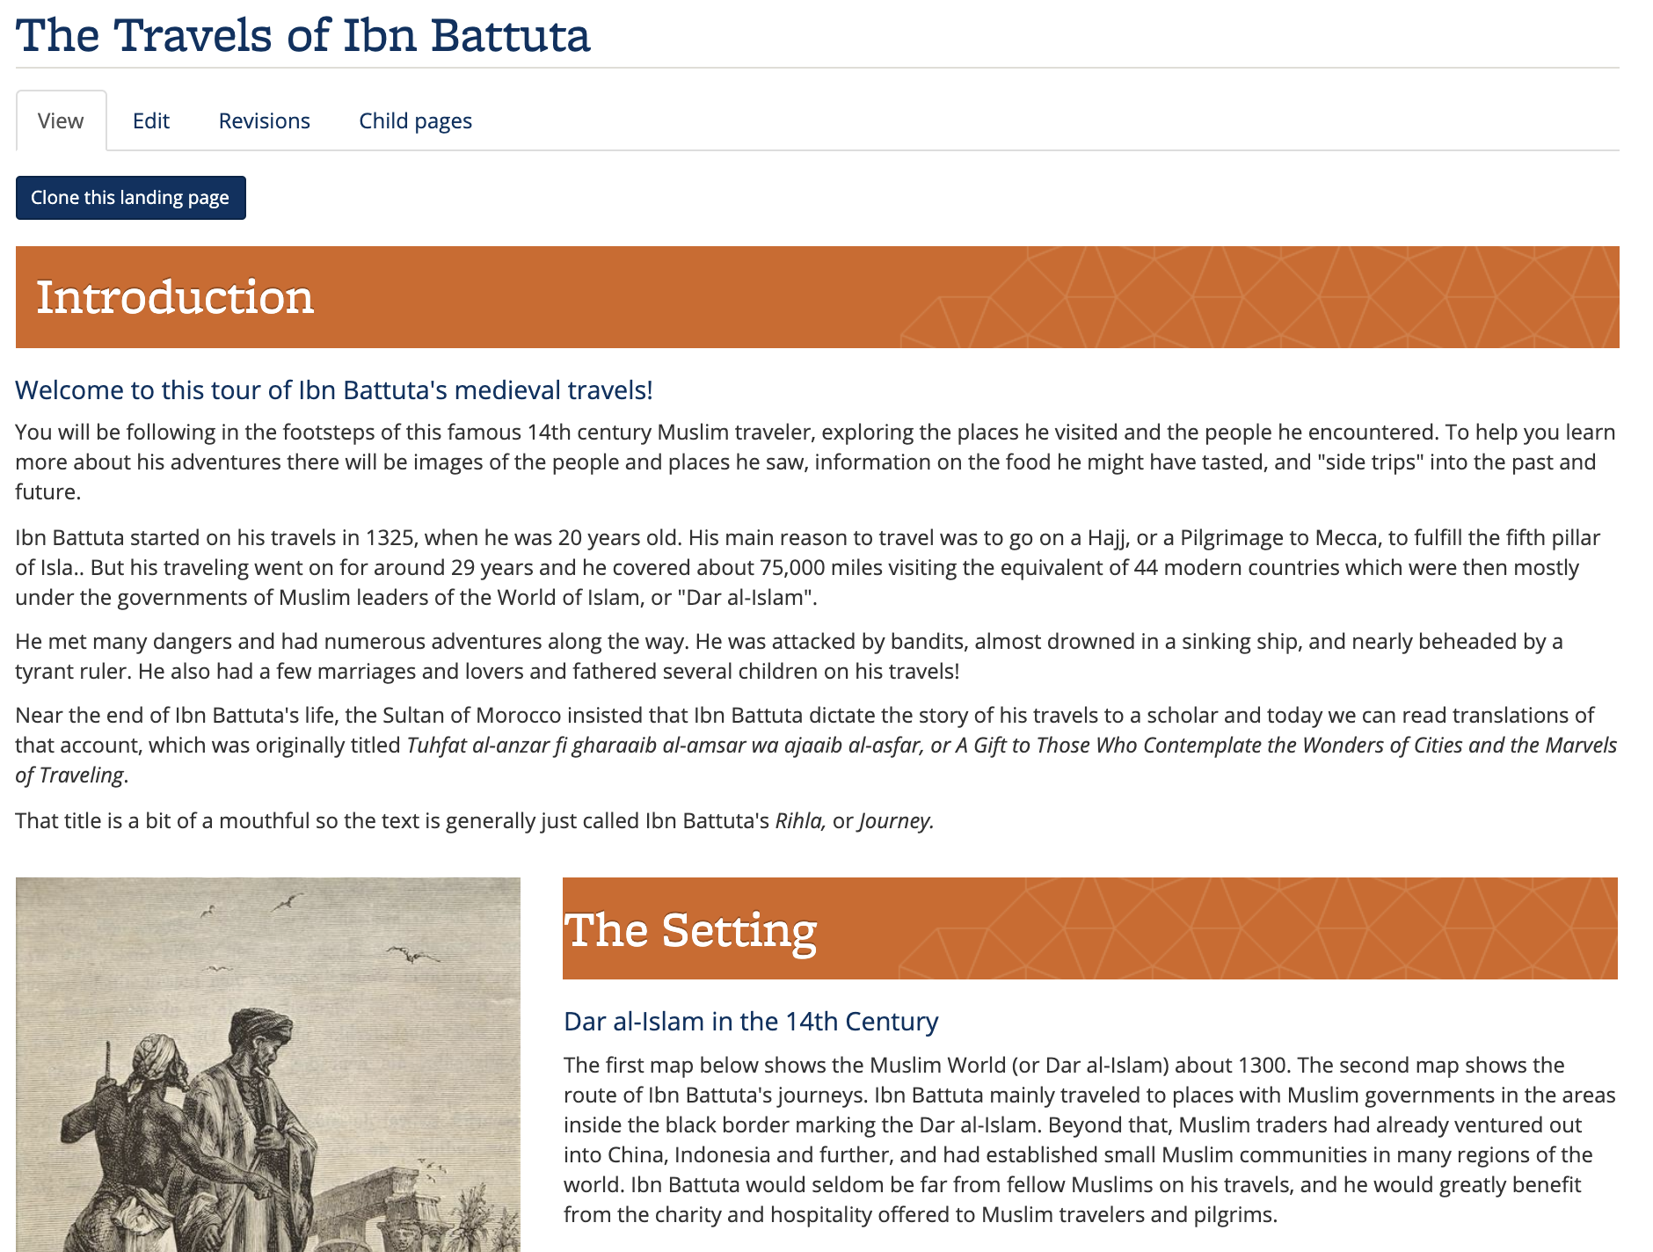

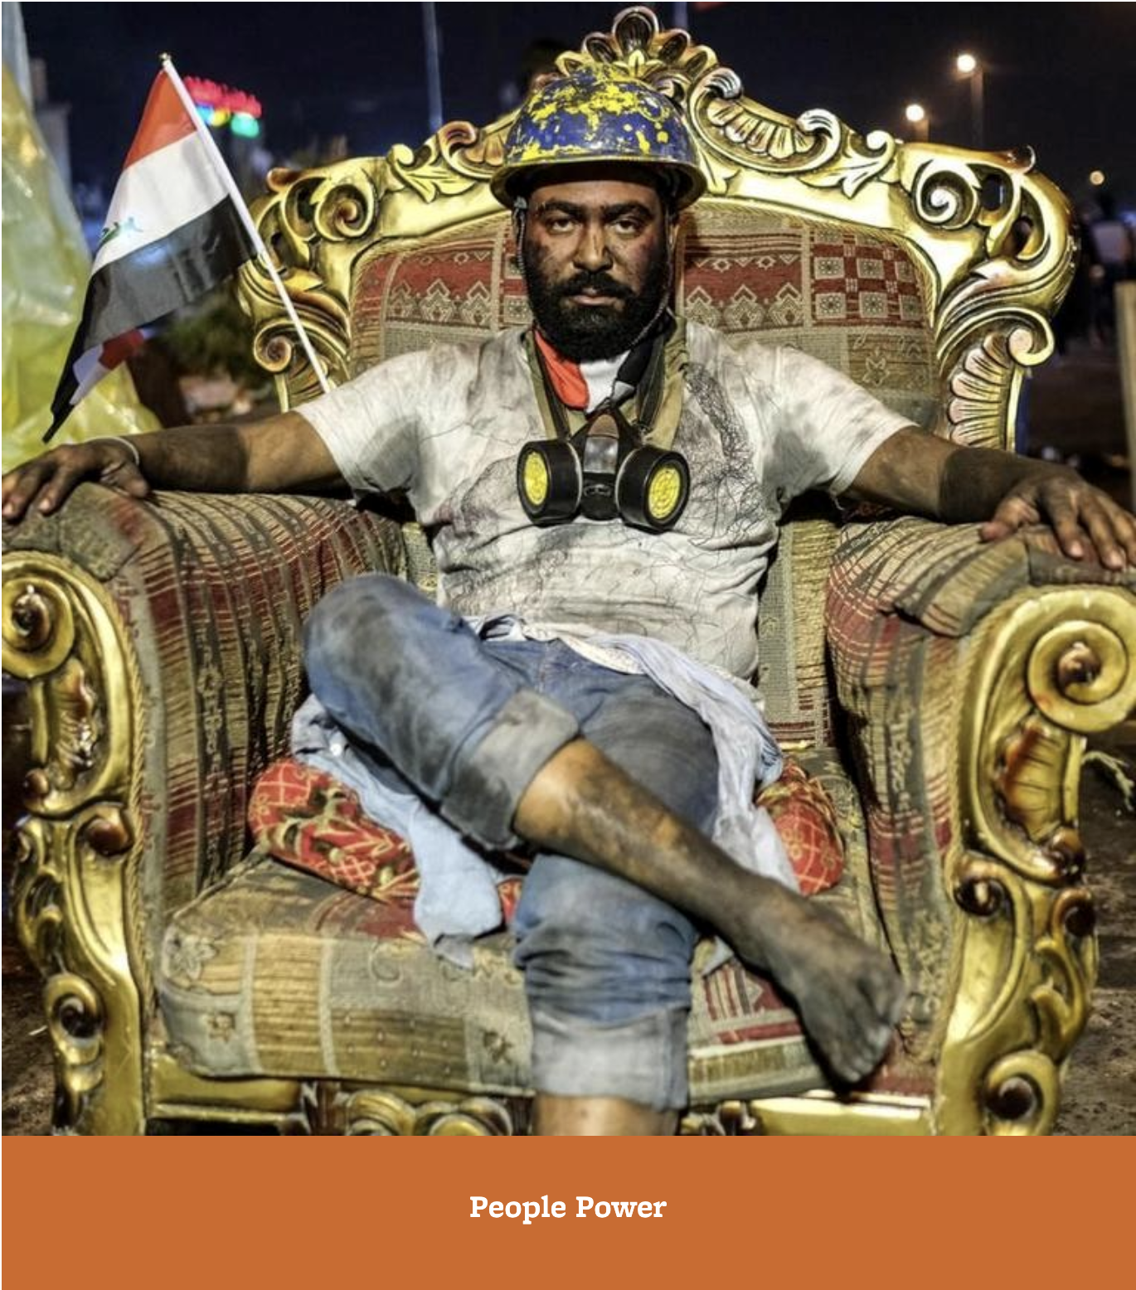


What is ORIAS?

Slide 7

UC Berkeley Professional Development Providers (UCBPDP)
Collaborative of 13 programs from across UC Berkeley providing PD for PK12
Committed to providing evidence-based PD for educators that supports deeper learning and continuous improvement
UCBPDP Website: http://bit.ly/BerkeleyPDP
UCBPDP Calendar: bit.ly/ucbpdp-calendar
UCBPDP Recordings and Resources: https://tinyurl.com/PDP-webinar-recording
Covid19 Resources for Educators: https://tinyurl.com/ucb-covid-resources

Slide 8
What is the TED Program?
The Transatlantic Educators Dialogue (TED) Program was founded in 2010 and brings together educators in the United States of America and the European Union for shared exploration and examination of a variety of educational topics, such as immigration, religion in education, active teaching methods and issues related to identity and difference.
K-12 teachers come from a wide variety of teaching contexts throughout the US and Europe
Throughout the Spring (February-May), participants meet weekly online (Noon Chicago time) on Sundays to discuss specific thematic topics, with groups of 5-6 educators assigned to lead discussion and present their perspectives each week.
Participants are encouraged to participate in a discussion board and develop their own collaborations and projects.
https://europe.illinois.edu/outreach/k-14-opportunities/transatlantic-educators-dialogue-program-ted

Slide 9
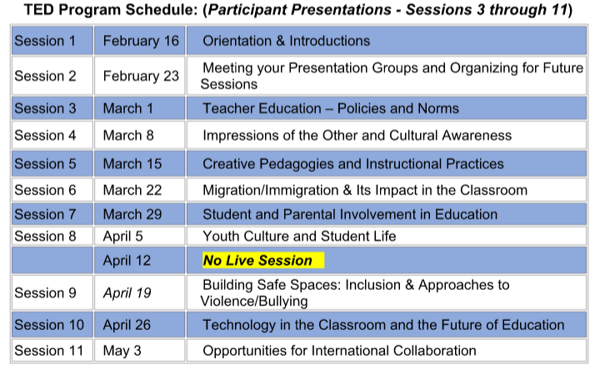
What is the TED Program?

Slide 10
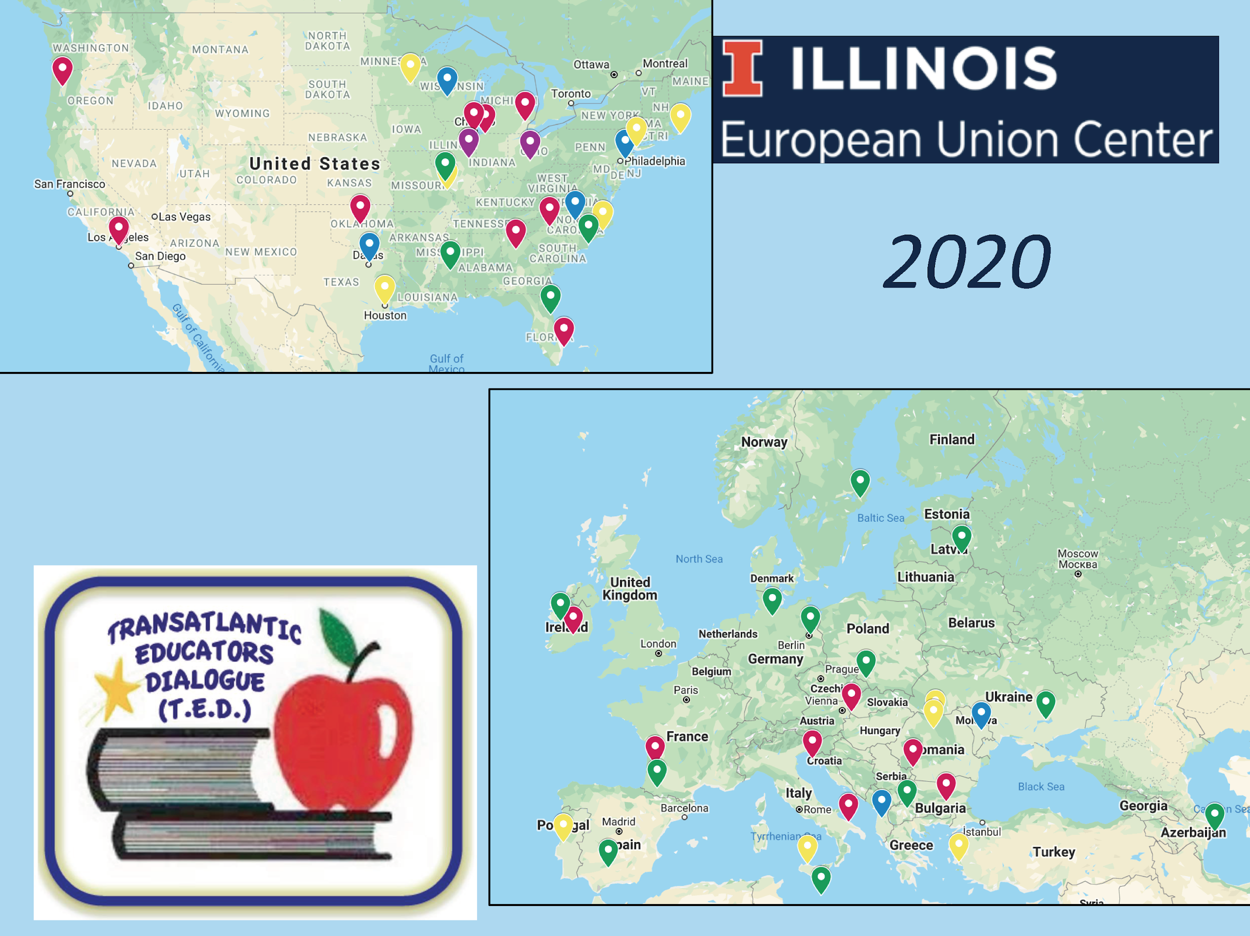

Slide 11
What is the TED Alumni Program?
Participants of the TED program are invited to apply to participate for the alumni program
Emphasis on developing collaborative working groups
Teachers select a project they would like to pursue with others and spend time during each session working toward their goal
Teachers also give mini-presentations on a topic of their choice
Teachers have worked on a range of topics from research studies to collaborative classroom Zoom meetings

Slide 12
TED Alumni Panelist Presentations
Joe Scanavino from Niantic, Illinois
Adriana Laze from Tirane, Albania
Mirko Labbri from Italy
Mark Lobes from Tinley Park, Illinois
Duane Johansen from Indiana
Magdalena Brzezinska from Poznan, Poland
Dabrowka Ujec from The Netherlands
Aleksandra Duric from Germany
Bill Hilt from Perrysburg, Ohio
Catherine Mein from Huxley, Iowa
Karla Milevoj from Labin, Croatia
Vincenza Leone from Milan, Italy

Slide 13
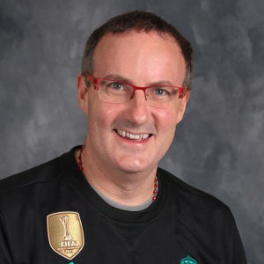

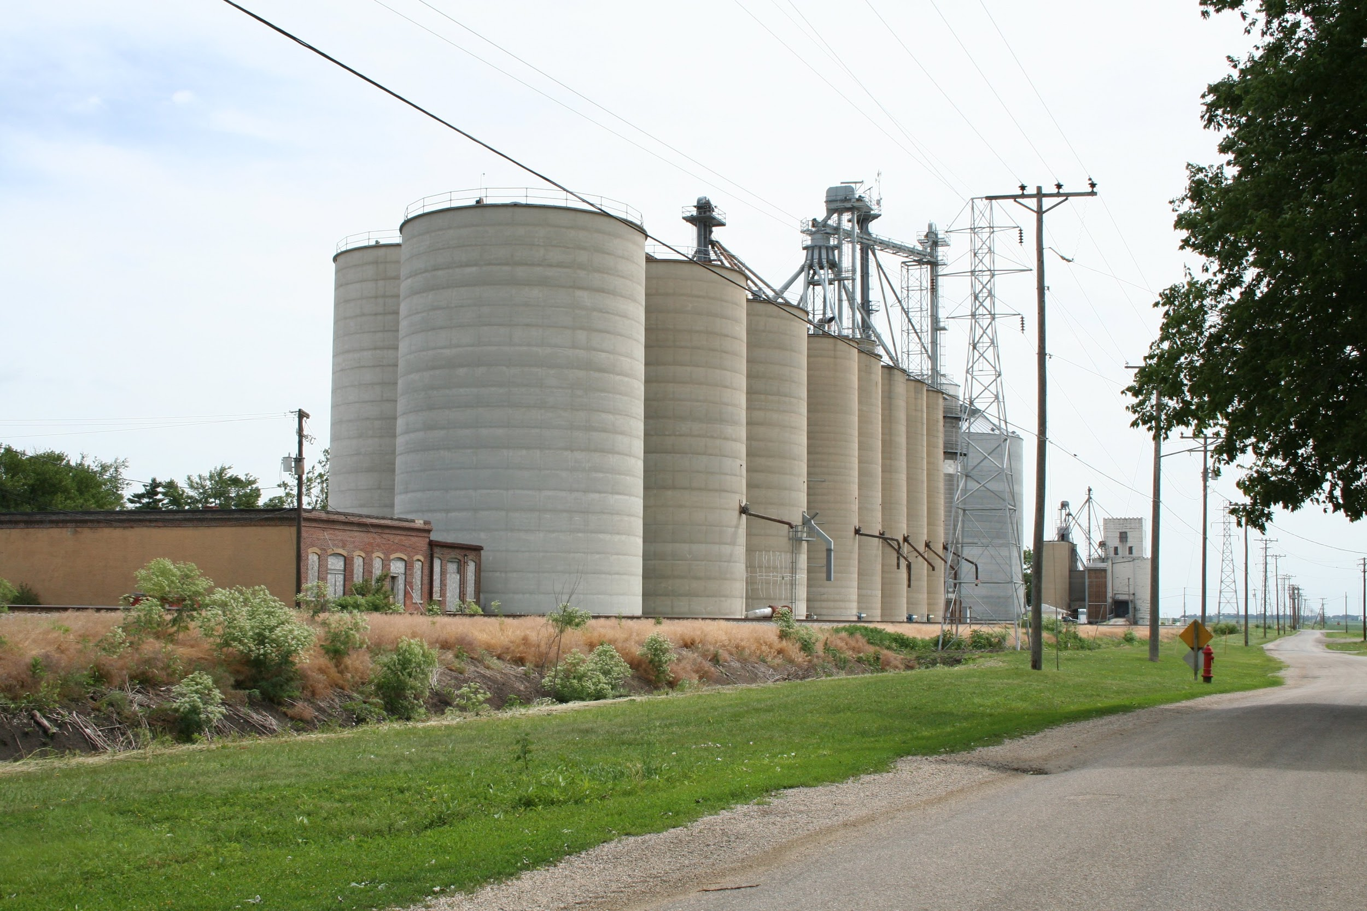
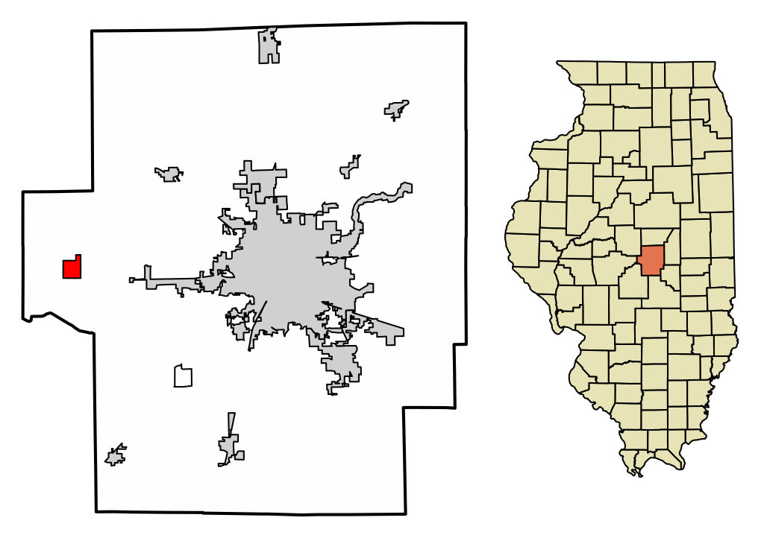
Joe Scanavino
German and Spanish Teacher
Sangamon Valley High School
-I teach German and Spanish at Sangamon Valley High School
-Our high school has 220 students total in classes 9-12 and around 36 teachers
-We started Remote Learning toward the end of March and will continue to the end of the school year….which for us is the middle of May.
-Remote Learning has been a challenge!

Slide 14

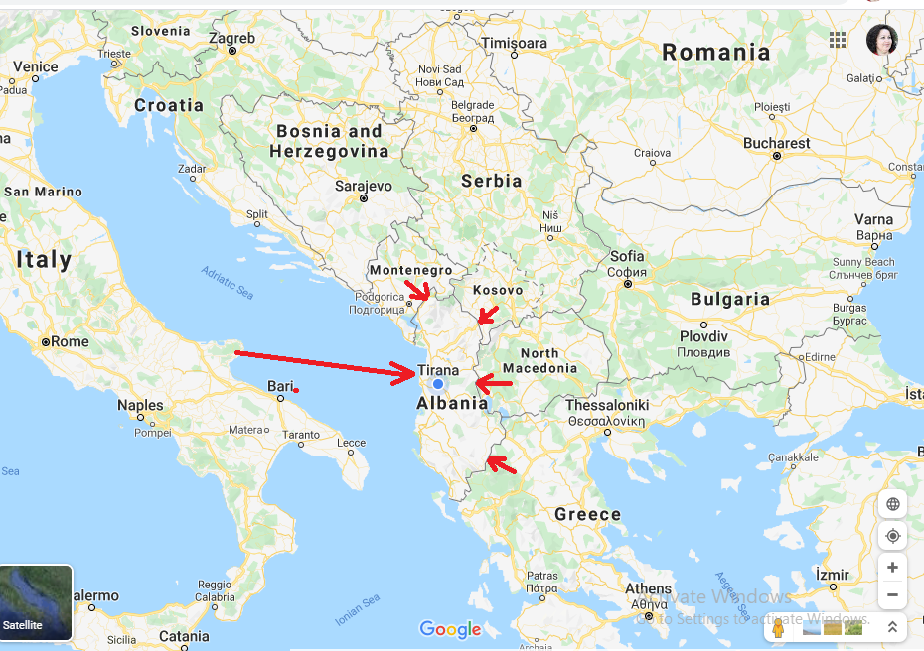
GLOBAL VIEWS OF COVID 2020
ADRIANA LAZE - ALBANIA
Math Teacher at Secondary School “ Katund i Ri “ (420 students ) Tirane , Albania
The age of my students: 12 – 15
Being a teacher
at 21-st century,
is not a challenge .
It is a multiple challenge
e Twinning & Scientix Ambassador
Some of my activities during Remote Teaching
10 March - First day of remote teaching + Creating group classes on WhatsApp
11 March – My first video learning
21 March - Teaching in time of Corona ( Online seminar in European Schoolnet )
23 March – A short tutorial video for my students regarding to Zoom
23 March - Created virtual classes in Google Classroom
24 March – A tutorial video for a combination: Google Classroom & Zoom
26 March – 2 short tutorial videos for Google classrooms for students and teachers
29 March – Used for the first time GeoGebra
31 March - Tutorial video for students how to realize online test in a google form
4 April - First puzzle with 4 pieces ( now with 100 ) for my Autic Student
April - Joined e Twinning project Our Quarantine Diary
……. To be continued ………
May 2 2020

Slide 15
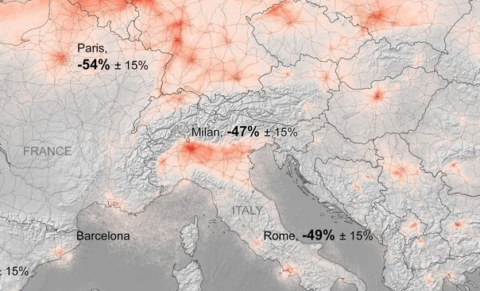
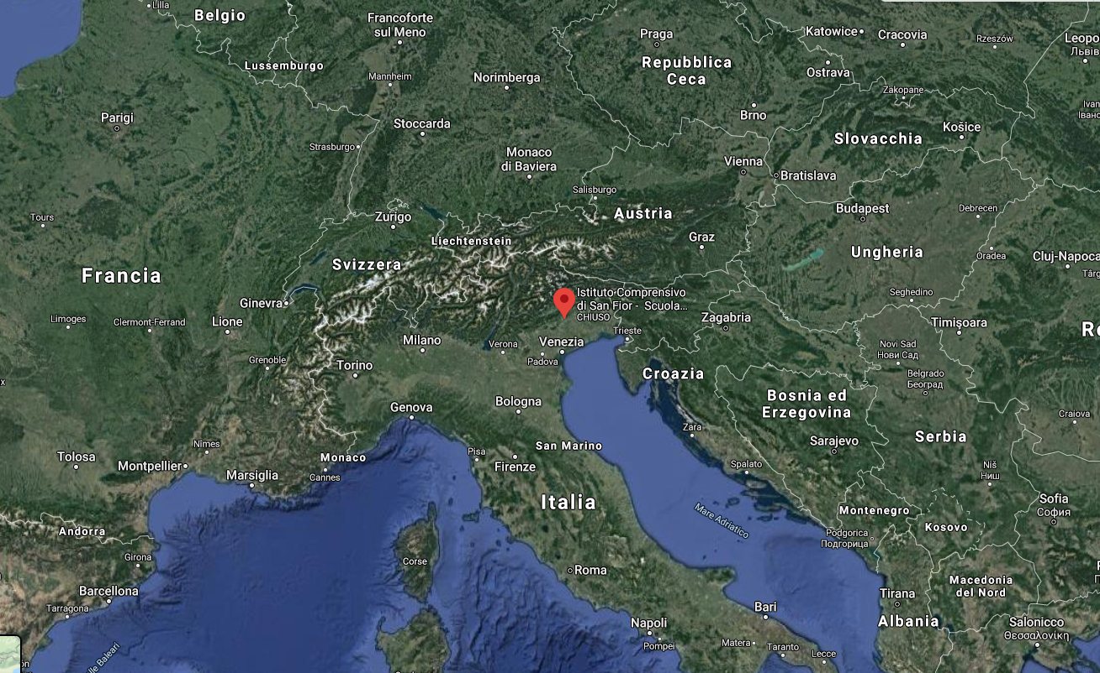
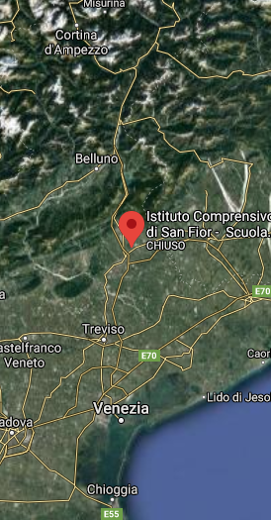
Mirko Labbri mirkolabbri@gmail.com
Training in Crisis
What is working ?
ITALY - Near Venice
_ Management
_ Self training
_ Teacher training
_ External training
_ Teacher satisfaction
_ Students satisfaction
900+ Students (Pri-Middle)
½ teaching time (Gsuite)
Started: March 9 (test)
Full classes: March 16
Not early, not late
No more parent interactions
Limited access to students
What is NOT working ?
_ Evaluation
_ Well being ?
_ Emotions?
_ Teaching ?
_ Learning ?

Slide 16


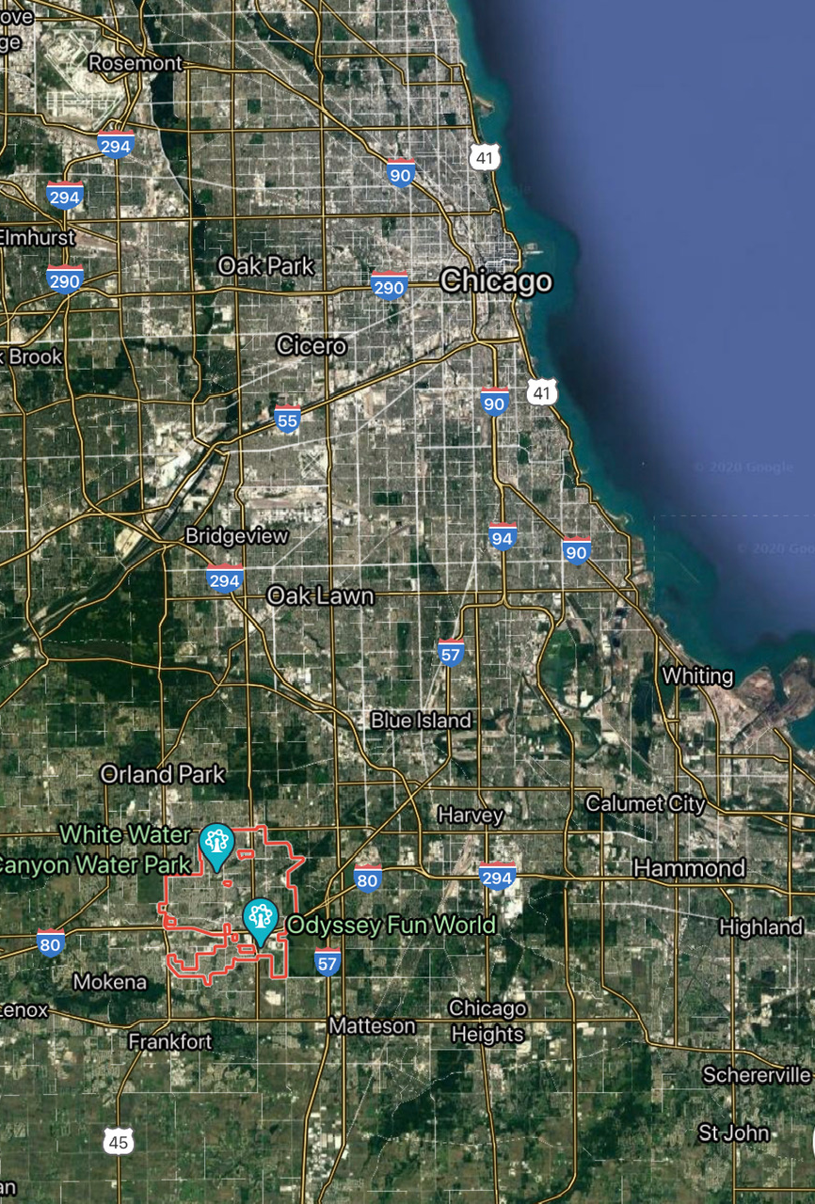
Mark Lobes
Victor J. Andrew High School
Tinley Park, IL
Location: Southwest Suburb of Chicago
Town Size: 56,000
Town Demographics: Middle to Upper Middle Class
School Type: Secondary / Comprehensive
School Size: 2,100 Students grades 9-12
Student Demographics: 90% college-bound
Student Devices: Dell Chromebook
Teacher Devices: HP EliteBook 360
Announcement of Closure: 13 March
First E-Learning Day: 16 March
School Learning Engagement Standards Announcement: 3 April
First State Distance Learning Day: 6 April
Announcement of State School Year Cancellation: 17 April
Final Day of School Year: 27 May
Summer School: Online Only / No Summer Sport Camps

Slide 17

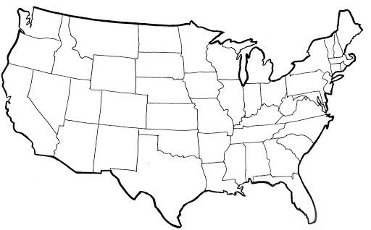
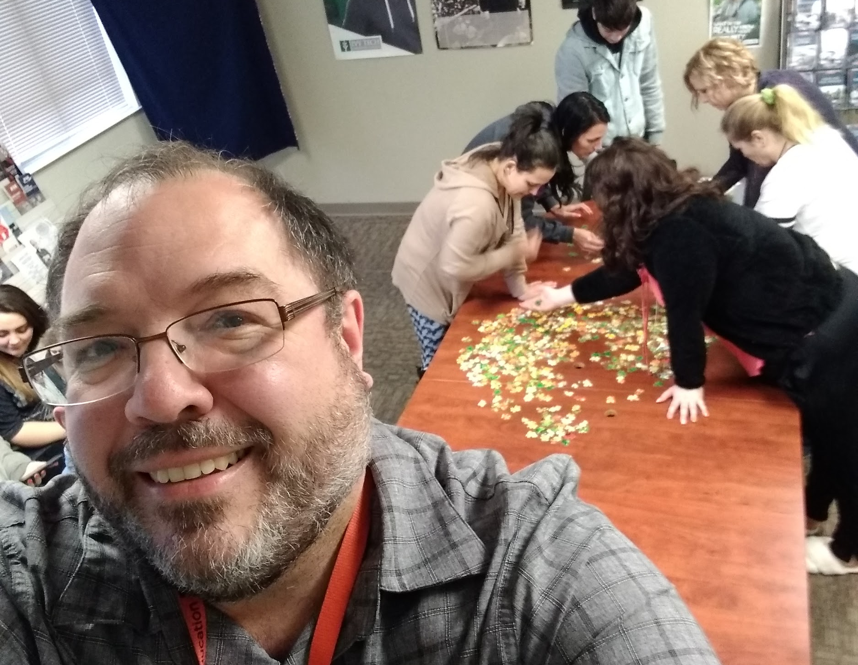
Duane Johansen
Humanities Instructor
The Excel Center Kokomo
Kokomo, Indiana, USA
High School for Adults (16-60+)
360+ Students Enrolled
10 Teaching Staff
14 Support/Administrative Staff
Last School Day: March 12 State Lockdown: March 23
Start of 5th Term: April 6 End of 5th Term: May 29
Staff Reports: July 6 Students Report: July 14

Slide 18
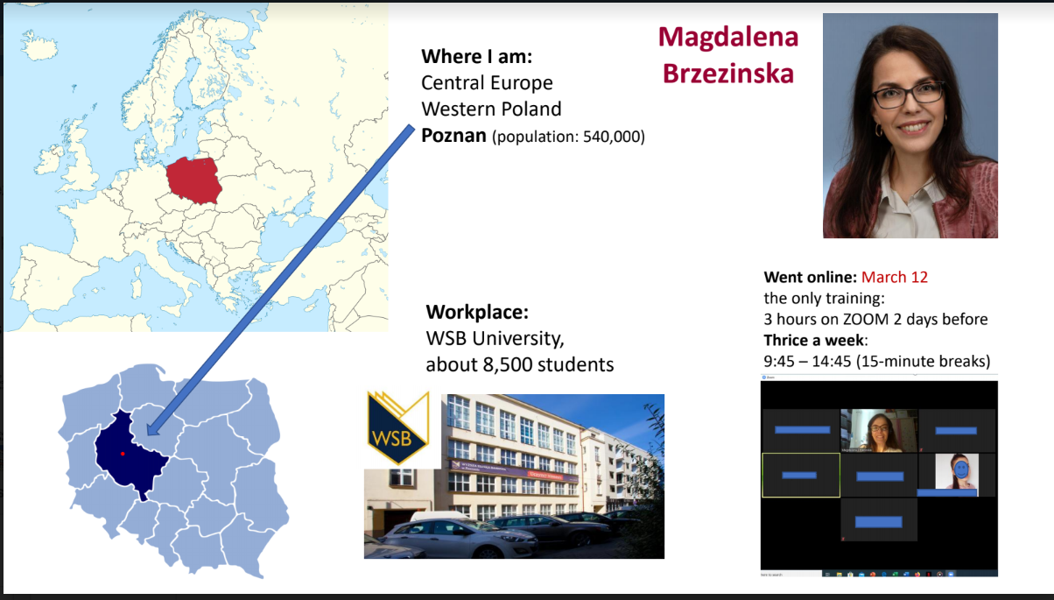

Slide 19

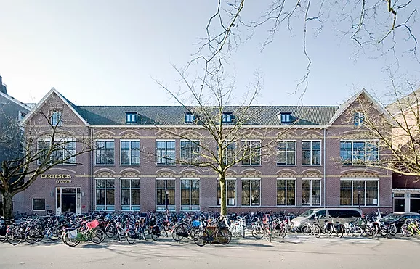
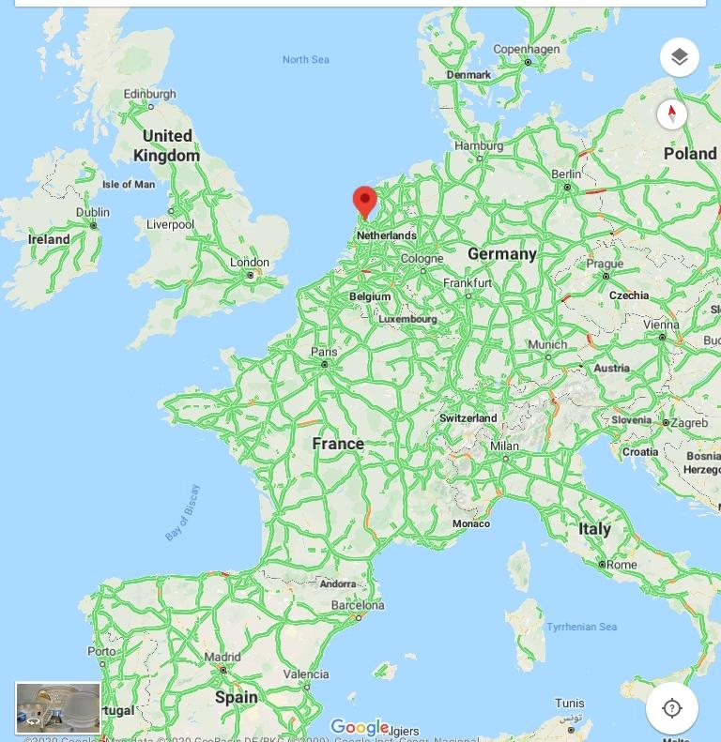

Cartesius Lyceum, Amsterdam (NL):
Mrs. Dabrowka Ujec (MA)
Cartesius Lyceum
a relatively small, grammar school hosting 750 students (ages 12-18) plus 80 members of staff.
situated in the western part of Amsterdam.
we are very proud to see how our students participate actively in the process of becoming European citizens, valuing the ideas of freedom, critical thinking, tolerance and open-mindedness.
since March 16th (week 1) we have been busy with distant teaching (Classrooms as a uniform platform for all of us)
every group has a compulsory meeting time (at least once a week /hangouts) and individual working time.
school exams were to be started on March 23rd (in school/week 2).
March 24th : school exams got postponed to further notice/national part of the final exams got cancelled.
April 6th: restarting of the school exams.
June 4th: the end of school exams (final exams).
school has stayed open since March 16th (only exam students)

Slide 20
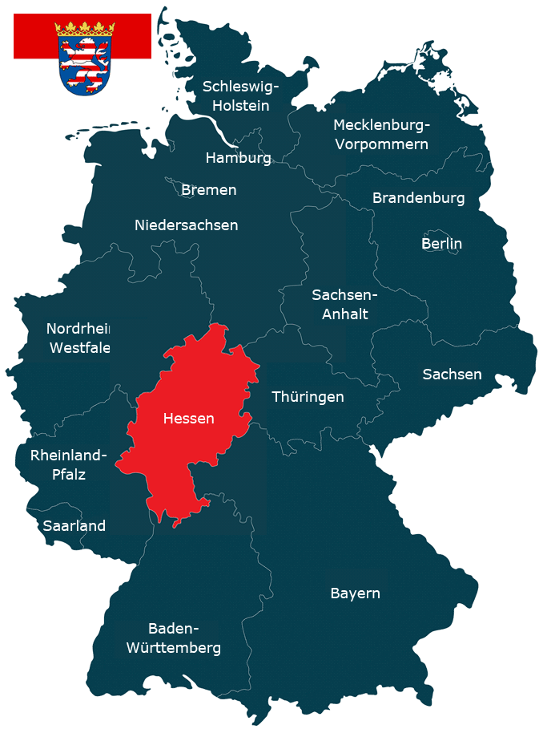
Teaching through Coronavirus: Footsteps towards inspiration or demotivation of teachers?
Problems:Teaching/learning materials,
parents, high school exam
27.4. grades 9. and 10. are returning to schools
16.MARCH 2020.
APRIL, 2020.
Hessen, Germany
MAY, 2020
August, 2020.
Problems: school start (4.5. or 11.5. 2020. – only 4. grade?), maintaining hygiene and social distancing (2m) in classes, possibility of domestic violence
Teaching is the greatest act of optimism. (Colleen Wilcox)
by Aleksandra Djuric

Slide 21
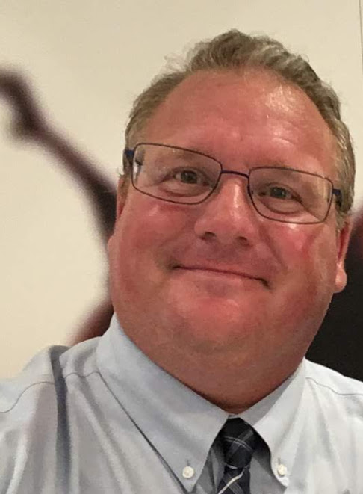
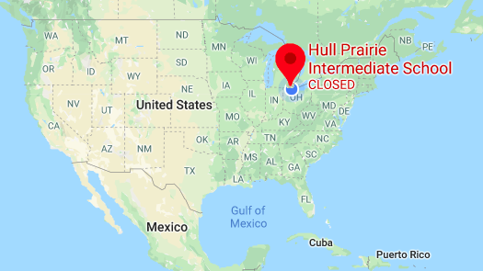


Bill Hilt, Hull Prairie Intermediate School
Perrysburg, Ohio USA
875 Students
Grades 5-6
Social Studies
Grade 5/6 Loop
Remote Teaching 3/13/20

Slide 22
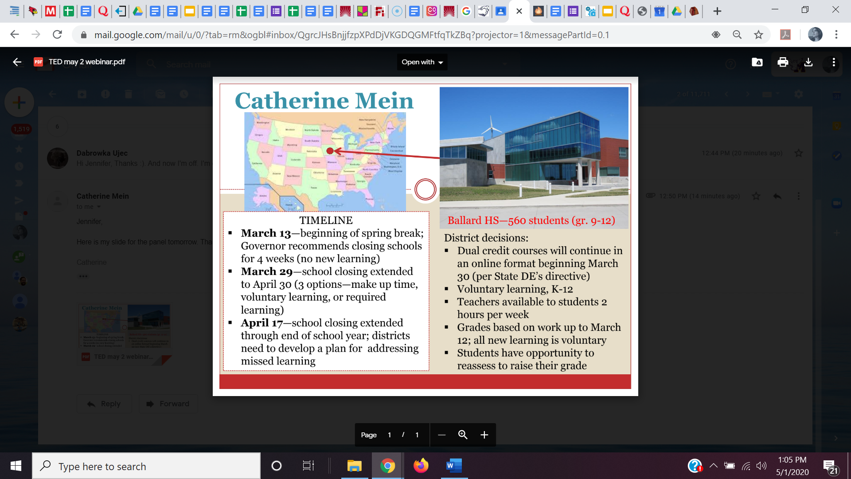

Slide 23
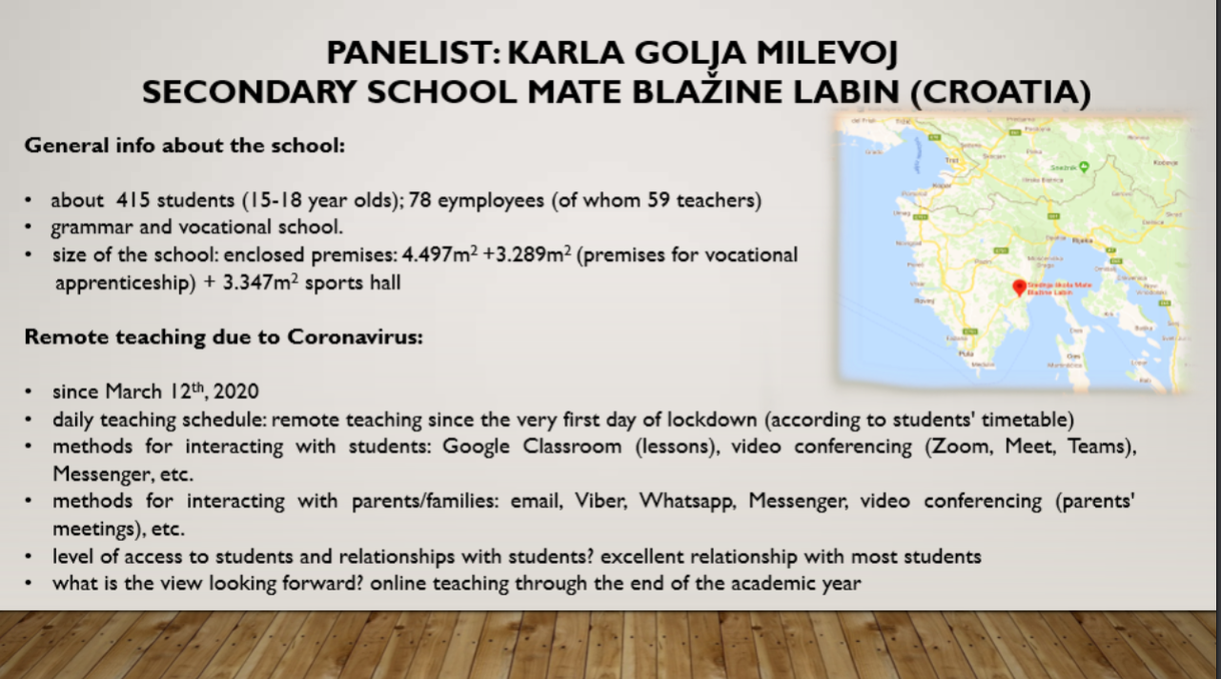

Slide 24
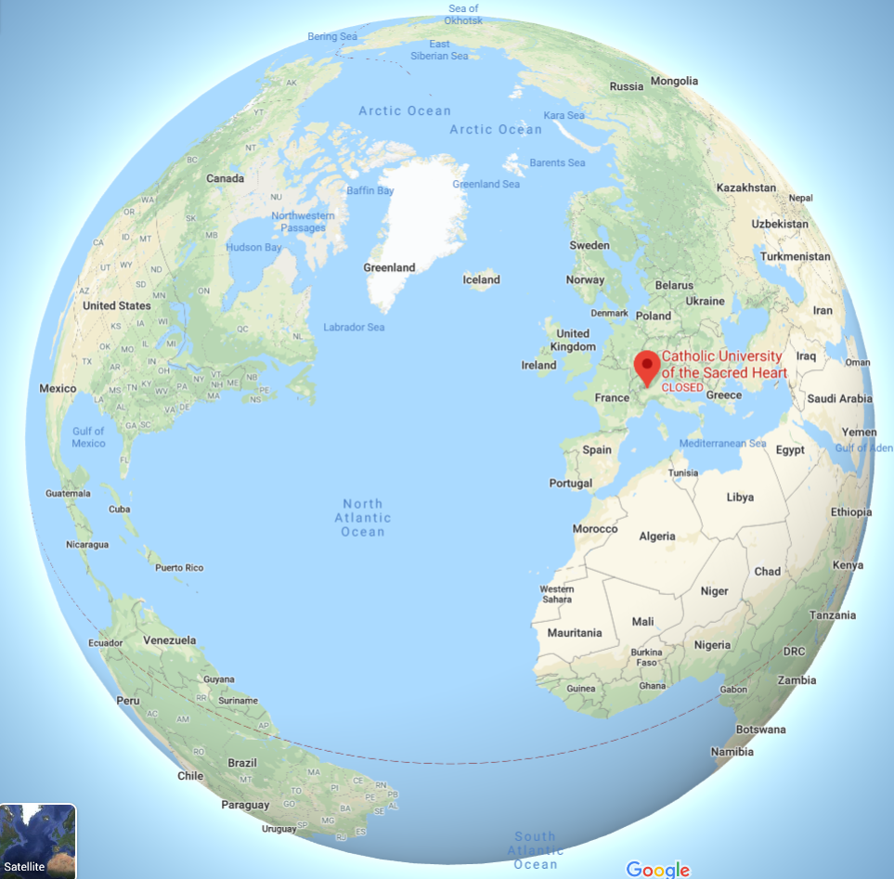

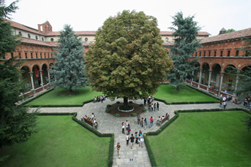
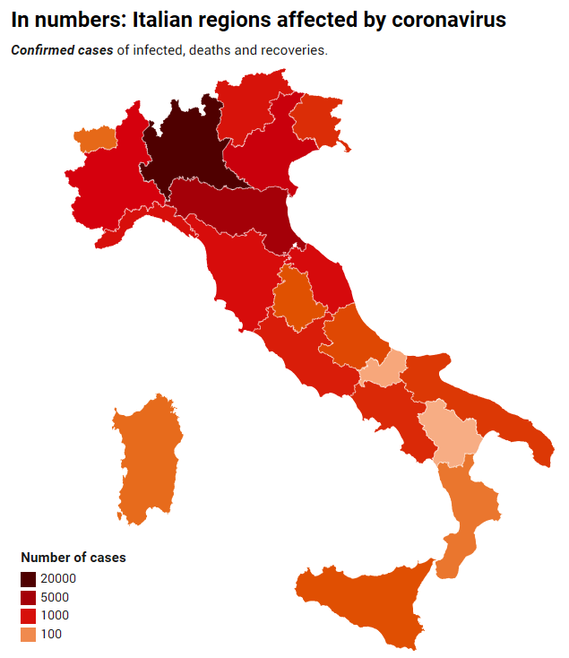
I am dr. Vincenza Leone, I teach Language Methodology at Catholic University of Milan (Italy). I am also an ESL teacher in a Lyceum of Milan and I have been selected by the Italian Ministry of Education to become part of a team of Expert teachers to support innovation in schools in the region of Lombardy.
Emergency in Lombardy started from 22nd of February: Schools in the region were closed.
From the 4th of March the Ministry of Education closed all schools in Italy and they will not open for this s.y.
1st week no one knew what exactly was going on.
2nd week some schools started to use emails and repositories to reach the students.
3rd week schools started to use e-learning platforms to teach (most used at the beginning Zoom. Now schools are mainly using Google Meet and Teams Meet).
Catholic University closed from the 22nd of February.
From the 2nd week of March we started to use e-learning.
The official platform is Collaborate Ultra.

Slide 25
Group Screenshot
Before you head off to your discussion groups, we’d like to take a quick group screenshot.
If you are okay with being in the photo turn your camera to ON.
If you don’t want your face in the shot, turn your camera to OFF.

Slide 26
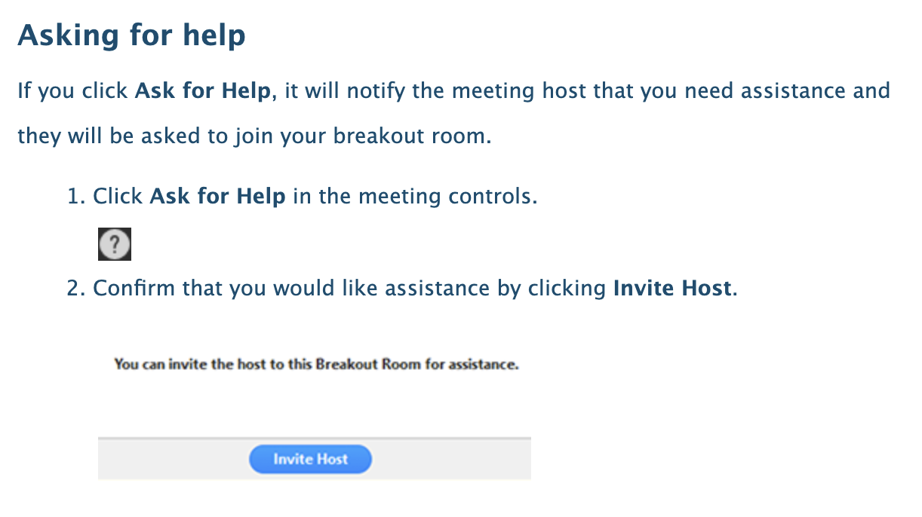
Discussion Group Norms
Unmute yourself when you enter the discussion room and keep your mic ON as much as possible.
Introduce yourself to the group alphabetically, based on the name that appears on the screen.
Share airtime. If you have commented multiple times please pause and allow a quieter person to speak.
If you do not have a pre-identified discussion leader, please select one.
Discussion lead should help moderate the group so that all voices are heard.
One fluent English-speaker should type notes into the chat box to help those who are less proficient.
Need help?

Slide 27
Discussion Group Prompts
How has your school responded to COVID-19, and what is a brief timeline of that response?
What is your daily teaching schedule?
How do you interact with your students and their parents or families? What technology platforms have you been using?
How has this new situation affected your relationships with your students? How is it affecting your ideas about what it means to be a teacher?
How have students adapted to online education?
Has your school implemented any new, temporary policies concerning grades, homework, attendance, etc.?
What challenges are you facing?
What is working well? What successes have you had?
How are parents and/or families involved in the education process?
What is the view going forward? Does your school anticipate returning to in-person instruction in the fall?

Slide 28
What did you learn?
What was the most valuable thing you learned today?
Write your reflection in the chat box,
then take a moment to read what others wrote.

Slide 29
Stay in touch
If you would like to share your contact information with other participants, type your email into the chat box.
It will not be used for any other purpose.

Slide 30
Optional Discussion #2
Say Goodbye!
OR
Rejoin your discussion group for 20 minutes

Slide 31
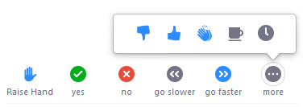
Discussion #2 Debrief
Questions:
What did you learn about your practice and your identity as a teacher?
What did you learn about the world?
Replies:
Please mute yourself when you are not speaking.
Please use the Raise Hand button

